Slide 1
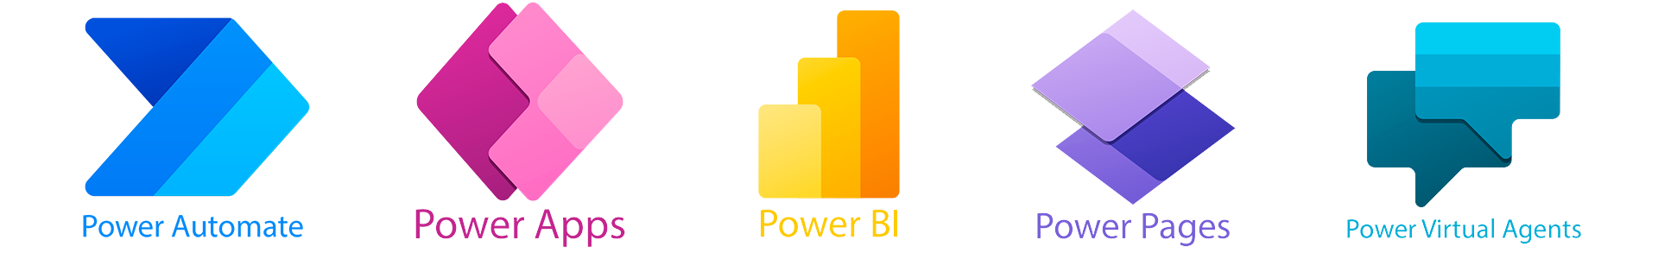



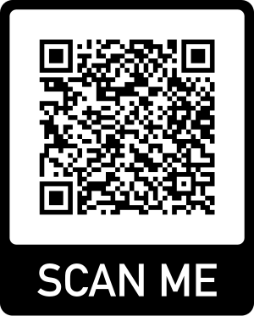
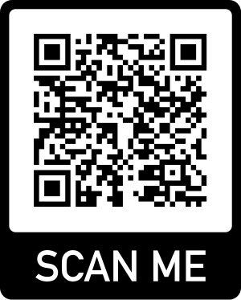
Copilot
Low Code/ No Code Power Platform
Virtual Conference
9th -10th November 2024
Welcome
REGISTER
DONATE
Supported by Microsoft Community

Slide 2
Copilot
Donate for the future of children
Low Code/ No Code Power Platform
Virtual Conference 2024
DONATE
Learning Together, Changing Lives
Supported by Microsoft Community

Slide 3

Copilot
Low Code/ No Code Power Platform
Virtual Conference 2024
Global Sponsor
Supported by Microsoft Community

Slide 4




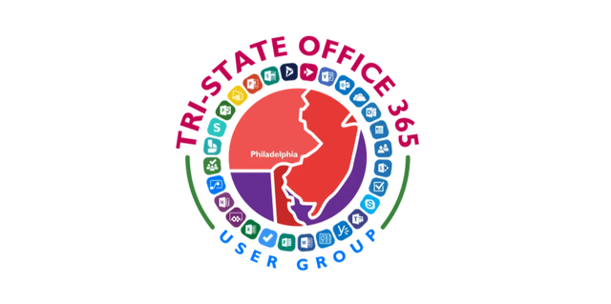


Copilot
Low Code/ No Code Power Platform
Virtual Conference 2024
Community Sponsor
Community Supporter
Supported by Microsoft Community

Slide 5
Start to Finish - building your automation

Slide 6
Start to Finish - building your automation
Understand the benefits of automation
Explore integration with other tools
Build a workflow starting from a Microsoft Form
Use connectors to send emails
Post an adaptive card to Teams
Notes:
Using Power Automate can be overwhelming. During this session, we will review the benefits of automation, best practices for configuration, and integration with other tools. The workflow that will be built using hands on will start from a Microsoft Form, use connectors to send emails and post an adaptive card to Teams!

Slide 7

Pat Petersen
Pat Petersen is a Director at RSM US LLP, a leading provider of audit, tax and consulting services. He has more than 20 years of experience in Information Technology and leads the Collaboration and Voice consulting practice at RSM. Pat specializes in Microsoft 365 platforms, such as Microsoft Teams, SharePoint, PowerApps, Power Automate, and Stream. In addition, he has extensive knowledge and experience in administration and training on these platforms and has conducted various customer immersion experiences and training sessions for RSM clients.
patpetersen.com
@prpetersen
https://www.linkedin.com/in/patrick-petersen-mn/

Slide 8
Get started with Power Platform

Slide 9
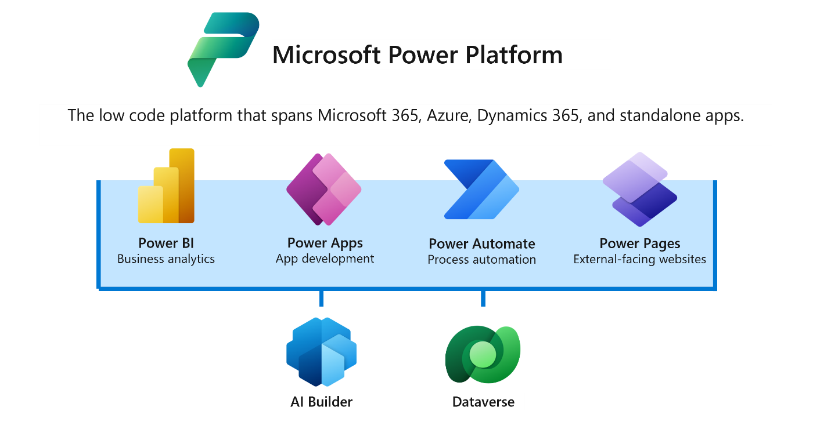
Products included in Microsoft Power Platform
Notes:
Power Apps
Power Apps provides a rapid low-code development environment for building custom apps for business needs. It’s a suite of app development services with a scalable data platform (Microsoft Dataverse) and an ability to interact with cloud and on-premises data sources. You use Power Apps to create web and mobile applications that run on all devices.
People use mobile apps in every area of their lives, and business should be no exception. Most out-of-the-box solutions don’t meet exact business needs or integrate well with other programs. Power Apps has a simple interface that eases users into app development, so that every business user or pro developer can build custom apps.
Power Automate
Power Automate lets users create automated workflows between applications and services. It helps automate repetitive business processes such as communication, data collections, and decision approvals. There’s no need to waste important productive hours on drafting the same email for a weekly update, or manually walking through approval processes. Power Automate can provide automations not only for the individual user, but also for enterprise-grade process automation. Its simple interface allows users with every technical competency (from beginners to seasoned developers) to automate work tasks.
Power BI
Power BI is a business analytics service that delivers insights for analyzing data. It shares those insights through data visualizations, which make up reports and dashboards to enable fast, informed decisions. Power BI scales across an organization and has built-in governance and security, to allow businesses to focus on using data more than managing it.
Consider Power BI as the analysis and insights leg of the Microsoft Power Platform. A Power BI dashboard could potentially replace a standing meeting to report on company metrics such as sales data, progress against goals, or employee performance.
Power Pages
Power Pages is a secured, enterprise-grade, low-code software as a service (SaaS) platform for creating, hosting, and administering modern external-facing business websites. Whether you’re a low-code maker or a professional developer, Power Pages enables you to rapidly design, configure, and publish websites that seamlessly work across web browsers and devices. Power Pages provides rich customizable templates, a fluid visual experience through a reimagined design studio, and an integrated learning hub to quickly build sites that suit your unique business needs.
Power Pages is the newest member of the Microsoft Power Platform family. With Power Pages, you build sites by using the same shared business data, stored in Microsoft Dataverse, that you use for building apps, workflows, intelligent virtual agents, reports, and analytics with other Power Platform components in your organization.
Among the products listed above, there are additional tools that enhance the solutions you create on the Power Platform. Some of these are:
AI Builder allows users and developers to add AI capabilities to the workflows and Power Apps they create and use. AI Builder is a turnkey solution that allows you to easily add intelligence to your workflows or apps and predict outcomes to help improve business performance without writing code.
Microsoft Dataverse is a scalable data service and app platform which lets users securely store and manage data from multiple sources. You can integrate that data in business applications using a common data model to ensure ease and consistency to users. Microsoft Dataverse is the common currency that enables the components of Power Platform to work together. It’s the foundation that enables the consolidation, display, and manipulation of data.
Connectors enable you to connect apps, data, and devices in the cloud. Consider connectors as the bridge across which information and commands travel. Connectors are used by Power Apps, Power Automate flow, and logic apps. There are more than 900 prebuilt connectors for Power Platform, enabling all your data and actions to connect cohesively. Examples of popular connectors include Salesforce, Office 365, X (formerly Twitter) , Dropbox, Google services, and more.

Slide 10
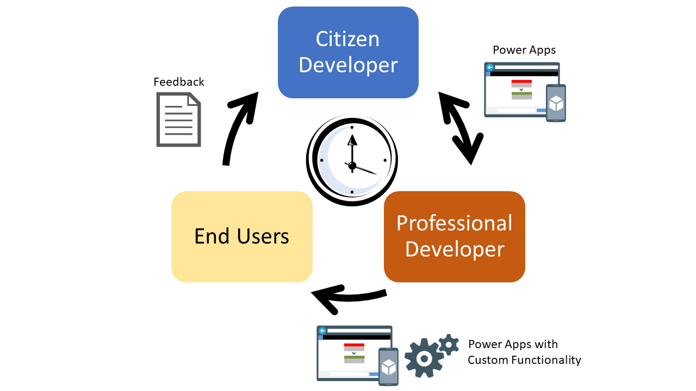
The business value of Microsoft Power Platform
Easily adapt to changing workforce expectations by delivering custom, collaborative, digital experiences.
Become more agile by quickly building solutions based on your organization’s rapidly-changing needs.
Reduce extra costs associated with custom applications by leveraging low-code/now-code tools.
Notes:
Changing workforce expectations: As millennials and Gen Z gradually form most of the workforce, organizations need to adapt to fit the way they work. These individuals have grown up in a world of tailored experiences and collaboration through social media. To best leverage their abilities, organizations should be able to deliver more custom, streamlined, and collaborative digital experiences.
Increased costs for custom application development: Building custom applications is time-consuming and expensive. You not only need to factor in the costs to initially custom develop an application, but you should also factor in the costs to maintain it.
Need to become more agile: Historically, solutions can take months to build and roll out. After deployment, it might take weeks to implement every minor change. We no longer have that luxury. Business strategies and needs change rapidly, so organizations must be able to quickly build solutions based on those changing requirements.
Need to scale development efficiently: To meet ever-changing needs, organizations must alter the ways in which they develop solutions. By responsibly enabling citizen developers (Power Users) as part of development processes, we create hybrid development teams that empower the entire organization to grow.

Slide 11
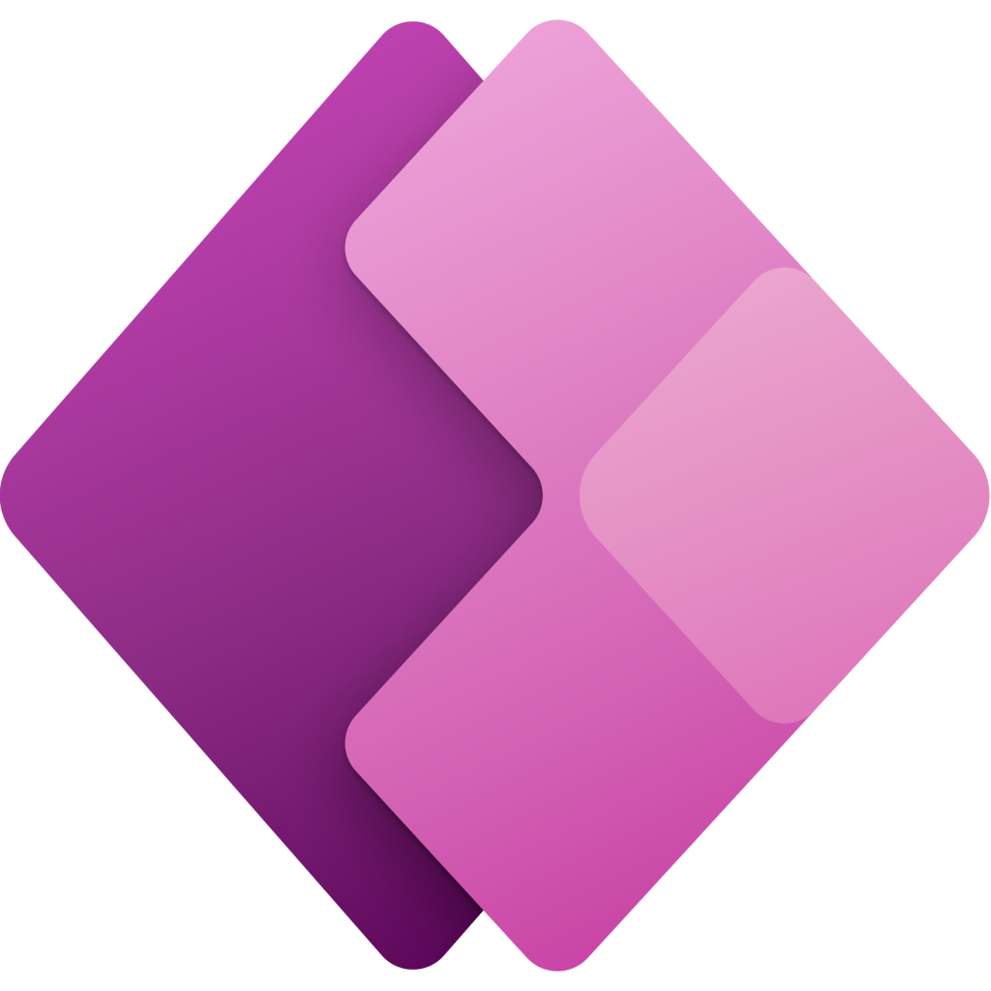
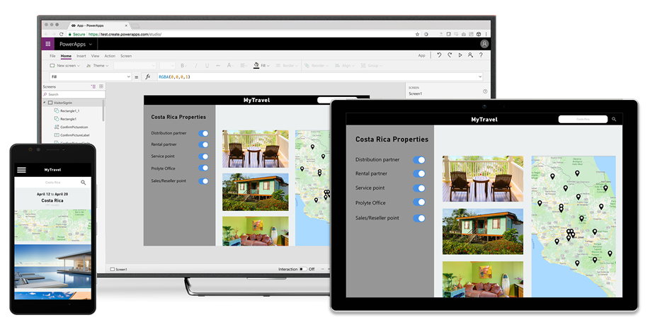
Power Apps
Build highly customized task- and role-based canvas apps with data from one or
multiple sources
Generate immersive model-driven apps, starting from your data model and business processes
Consume fully accessible apps across web and mobile, embedded or standalone,
on any device
Notes:
Power Apps is a rapid, low-code development environment that app makers can use for building custom apps for business needs. It's a suite of app development services with a scalable data platform (Microsoft Dataverse) and an ability to interact with cloud and on-premises data sources. With Power Apps, app makers can create web and mobile applications that run on all devices.
Two types of applications that makers can build with Power Apps are:
Canvas applications - Canvas apps are typically task-focused apps where makers can drag and drop different components and position them how they want to create a user interface.
Model-driven applications - Model-driven apps are connected to Microsoft Dataverse. Makers build model-driven apps by adding different components, such as forms, views, charts, and dashboards, to tables by using an app designer tool.
As an app maker, you need to determine what type of application you need to create based on what you need it to do. The most common type of app is a canvas application because you can connect them to multiple data sources and the user has complete control over the UI.
This module explores when to use each type of app in more detail later.
For more information about building applications with Power Apps, see the following documentation:
Create a canvas app in Power Apps
Create a model-driven application in Power Apps
Get started using Dataverse

Slide 12

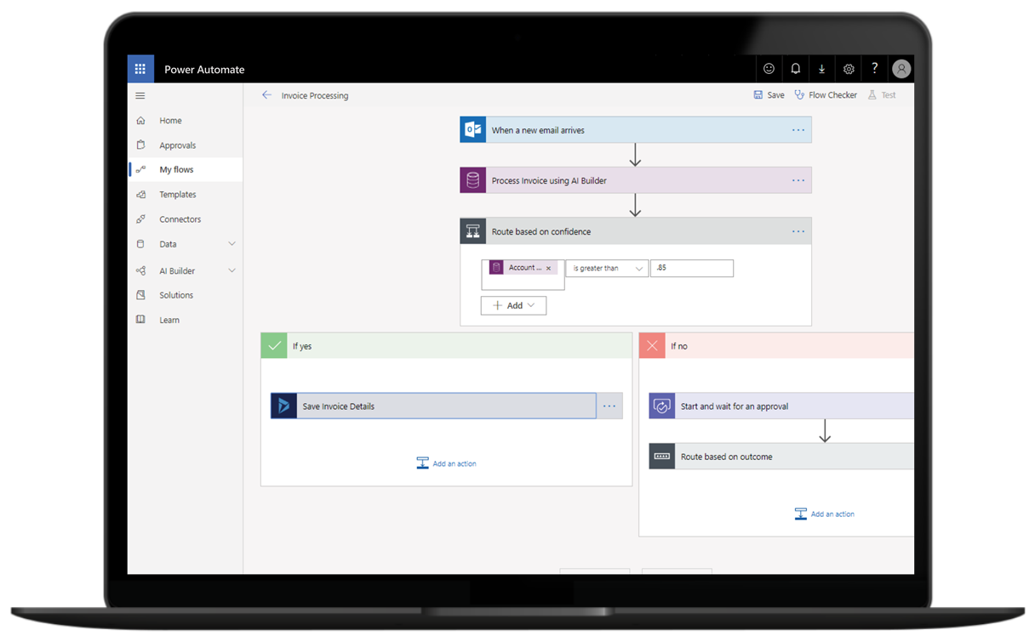
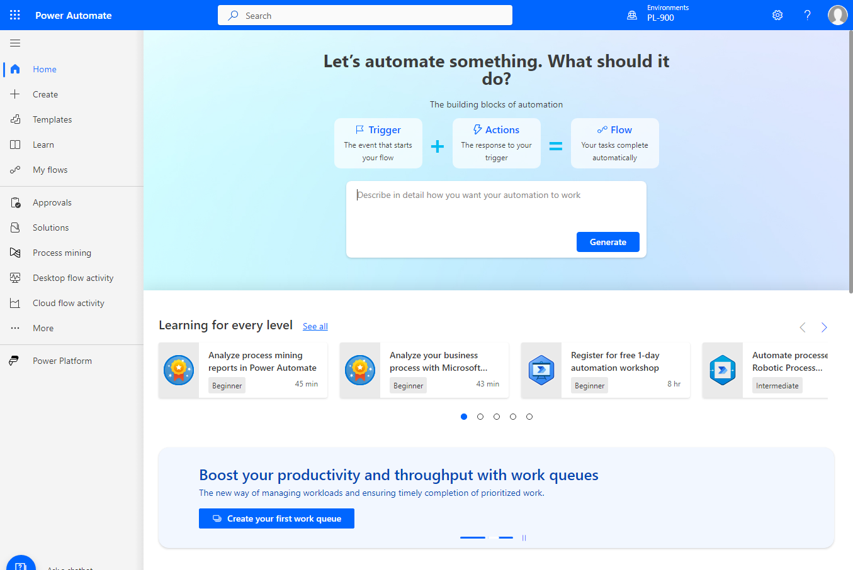
Power Automate
Automate and model business processes across your apps and services
From simple automations to advanced scenarios with branches, loops, and more
Trigger actions, grant approvals, and get notifications right where you work
Automate legacy, on-prem and cloud-based applications and services
Notes:
Organizations can use Power Automate to build automated workflows between applications and services. Power Automate helps automate repetitive business processes, such as communication, data collections, and decision approvals. Power Automate provides enterprise-grade automation that makers can use across an entire organization. Additionally, it provides a user-friendly UI for makers and individual users to create automations that simplify their daily activities.
The four primary types of operations in Power Automate flows are:
Business process flows - Use these flows in model-driven apps to help people get work done. These flows provide a streamlined user experience that leads people through the processes that their organization has defined for interactions that need to be advanced to some type of conclusion.
Cloud flows - These flows are most frequently used. Cloud flows begin with a trigger, such as receiving an email from a specific person or a mention of your company in social media. When the flows are triggered, they also generally include one or more actions, such as creating a record in a different system or sending an approval request to someone.
Desktop flows - Use these robotic process automation (RPA) flows to record yourself performing actions on your desktop or within a web browser. Then, you can trigger a flow to perform that process for you. You can also pass data in or get data out of the process so that you can automate "manual" business processes.
Process mining - Use process mining and task mining in Power Automate to gain a better understanding of your business processes so that you can optimize them.

Slide 13
Power Automate overview

Slide 14
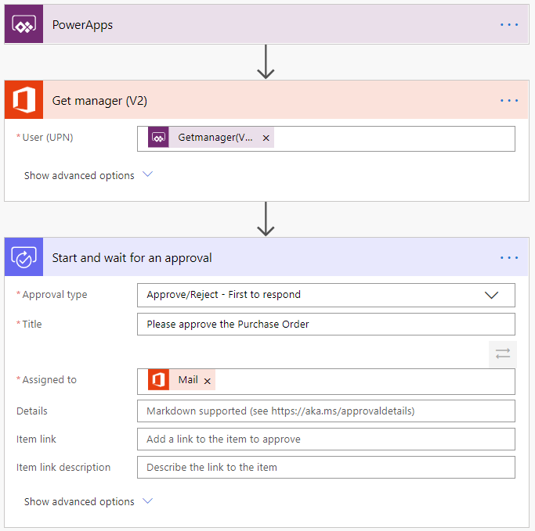

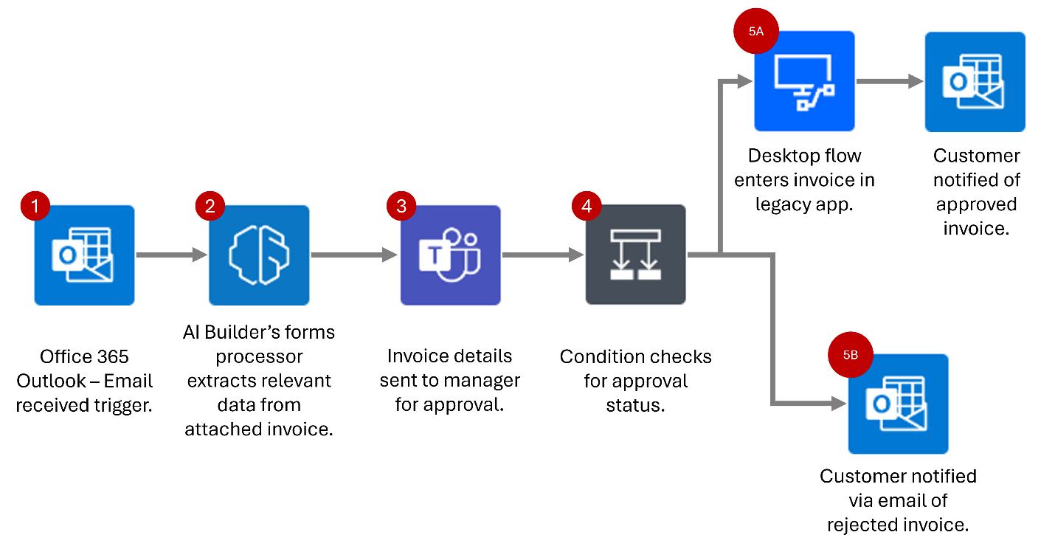
The value of Power Automate
  Common scenarios and capabilities:
  Automating repetitive tasks.
  Guiding a user through a process.
  Connecting to external data sources.
  Automating desktop-based processes.
Notes:
Do you find yourself downloading email attachments and then uploading the file to the database? Power Automate can help. Does the process of getting a new purchase order approved involve you taking a form from desk to desk to get sign-off? Power Automate can help. Do you have to log in to a website every morning, find the daily numbers, and then save those into another system? Power Automate can help.
Power Automate is all about having computers manage repetitive tasks. Power Automate allows anyone with knowledge of the business process to create a repeatable flow that, when triggered, leaps into action and performs the process.
Common scenarios and capabilities of Power Automate:
Automating repetitive tasks like moving data from one system to another.
Guiding a user through a process so they can complete the different stages.
Connecting to external data sources via one of the hundreds of connectors, or directly via an API.
Automating desktop-based processes with robotic process automation (RPA) capabilities.
We’ll dive into the example flow in the following slides.

Slide 15
What can you do with Power Automate?
Power Automate automates workflows between your favorite applications and services, sync files, get notifications, collect data, and more
For example, you can automate these tasks:
Instantly respond to high-priority notifications or emails
Capture, track, and follow up with new
sales leads
Copy all email attachments to your OneDrive for Business account
Collect data about your business, and share that information with your team
Automate approval workflows
Notes:
You can use Power Automate to automate workflows between your favorite applications and services, sync files, get notifications, collect data, and much more.
For example, you can automate these tasks:
Instantly respond to high-priority notifications or emails.
Capture, track, and follow up with new sales leads.
Copy all email attachments to your OneDrive for Business account.
Collect data about your business, and share that information with your team.
Automate approval workflows.
A common use of Power Automate is to receive notifications. For example, you can instantly receive an email or a push notification on your phone whenever a sales lead is added to Dynamics 365 or Salesforce.

Slide 16
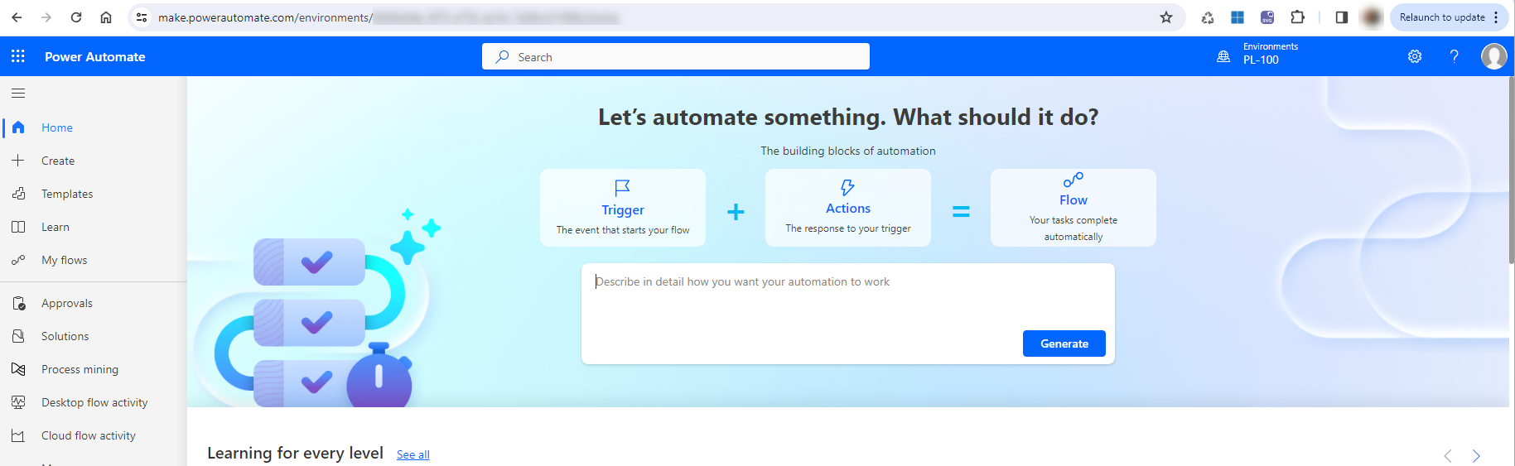
A brief tour of Power Automate
Flows can be created from: https://make.powerautomate.com
Notes:
Let's jump into Power Automate, and we'll show you around. We have tons of information for you to learn about how to use Power Automate.
When you sign in to Power Automate, you'll find these menus:
Action items, where you can manage approvals and business process flows.
My flows, where your flows reside.
Create, where you start a new flow.
Templates, where you can take a look at some of the most popular templates. These should give you some great ideas for flows you want to try.
Connectors, where you can connect from one service to another.
Data, where you can access tables, connections, custom connectors and gateways.
Solutions, where you can manage your solutions.
Learn, where you can find information that will help you quickly ramp up on Power Automate.
For now, let's focus on the ? menu next to your login, which has these options:
Documentation is where our advanced topics reside. If you want to really understand a feature or function, you can do a deep dive here to figure things out.
Learn has learning paths to guide you through using Power Automate, all the way from beginning techniques to advanced scenarios.
Support is a great landing place to find help.
Roadmap is where you can get a glimpse into what will be made in the next product update.
Community is a place to plug into and find out how other people use Power Automate.
Give Feedback taps into a community of power users, and is where you can send comments and questions to developers and other experienced users.
Blog keeps you up to date about the most recent developments and releases in the Power Automate ecosystem.
Pricing can help you choose the right plan for you or your business.

Slide 17
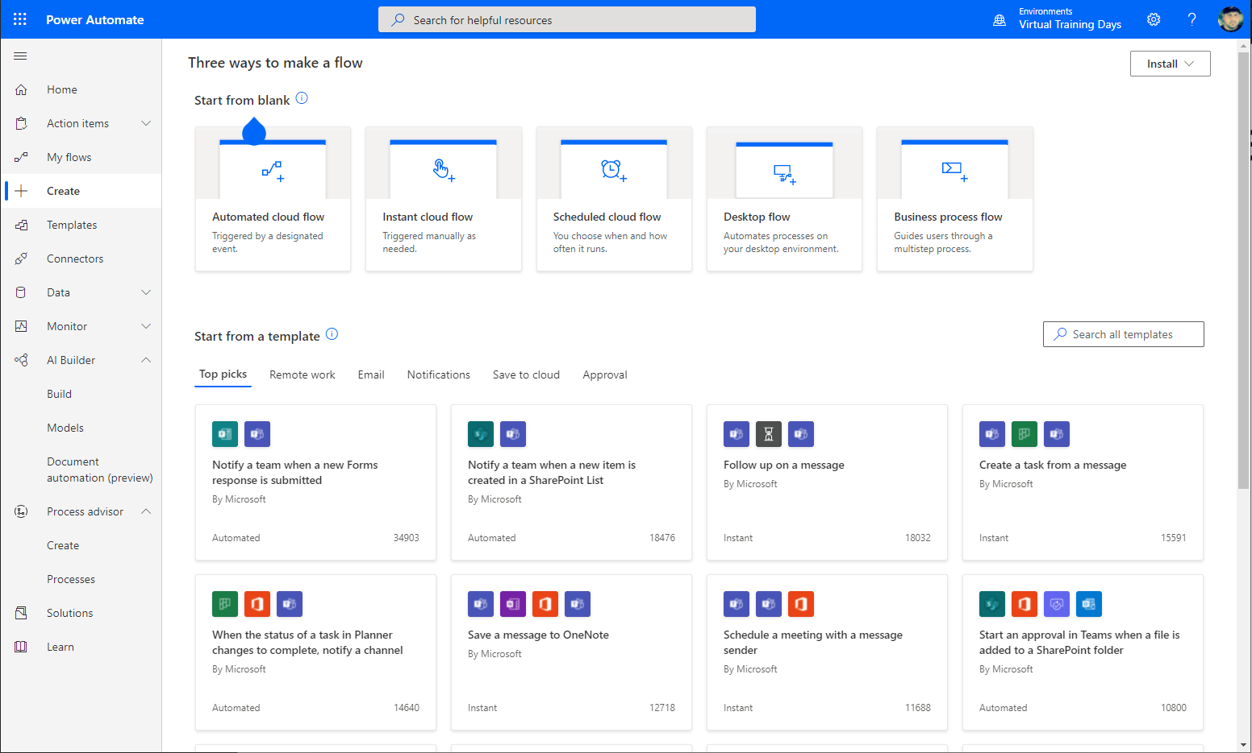
The three types of flows you can create with Power Automate
Power Automate works by creating flows—here are the three types:
  Cloud flows (API)
    Instant
    Automated
    Scheduled
  Business process flows (BPM)
  Desktop flows (RPA)
Notes:
Power Automate works by creating flows—there are three types:
Event driven flows—these are flows that you build with a trigger that has one or more actions. Thanks to the existing connectors, there’s a multitude of triggers and actions available. You’ll see these as “My flows” and “Team flows” in Power Automate. The only difference between a My flow and a Team flow is ownership. With a My flow, you are the sole owner, while a Team flow has more than one owner.
Business process flows—these flows are built to augment the experience when using model-driven apps and Dataverse. Use these to create a guided experience in your model-driven apps.
Desktop flows—formerly known as UI flows. These RPA flows allow you to record yourself completing actions on your desktop, or within a web browser. You can then trigger a flow to do that process for you. You can also pass data in or get data out of the process, so you can automate even "manual" business processes.

Slide 18
Power Automate screen
When you sign into Power Automate, you’ll find these menus:
Home: Takes you to the main screen for Power Automate
Create: Where you start a new flow
Templates: Where you can look at popular templates
Learn: Where you can find training content related to Power Automate
My flows: Where your flows reside
Approvals: Where you manage approvals and business process flows
Process Mining: Where you can use process mining features to optimize your business processes
Solutions: Where you can manage your solutions
Power Platform: Provides quick access to the other Power Platform admin and maker portals
Notes:
Home: Takes you to the main screen for Power Automate
Create: Where you start a new flow
Templates: Where you can look at popular templates
Learn: Where you can find training content related to Power Automate
My flows: Where your flows reside
Approvals: Where you manage approvals and business process flows
Process Mining: Where you can use process mining features to optimize your business processes
Solutions: Where you can manage your solutions
Other items that you may see
AI Hub:
Tables:
Connections:
Desktop flow Activity:
Cloud flow activity
Work queues
Machines:

Slide 19
Example: A purchase order approval
  Approvals are a great process to build in Power Automate. They are often defined yet manual. Check out the following scenario for an example:
  A user starts the process by going into a Power Apps app and creating a purchase order request. After they submit the request, the information is sent to a Power Automate flow.
  The flow can be built to evaluate the request and then route it based on criteria such as submitting user and request amount. The first action could be to send the request to the user’s manager. The manager might be automatically retrieved from Azure AD, avoiding a prompt for duplicate information.
Notes:
Most organizations have some type of approval process that could benefit from automation. For example:
Time off
Invoice approval
Project sign-off

Slide 20
Example: Purchase order approval
Notes:
Approvals are a great process to build in Power Automate. They are often defined yet manual. Check out the following scenario for an example:
A user starts the process by going into a Power Apps app and creating a purchase order request. Once they submit the request, the information is sent to a Power Automate flow.
The flow can be built to evaluate the request and then route the request based on criteria such as submitting user and request amount. The first action could be to send the request to the user's manager. The manager could be automatically retrieved from Azure AD, avoiding prompting for duplicate information.
Here is the starting point of the flow.

Slide 21
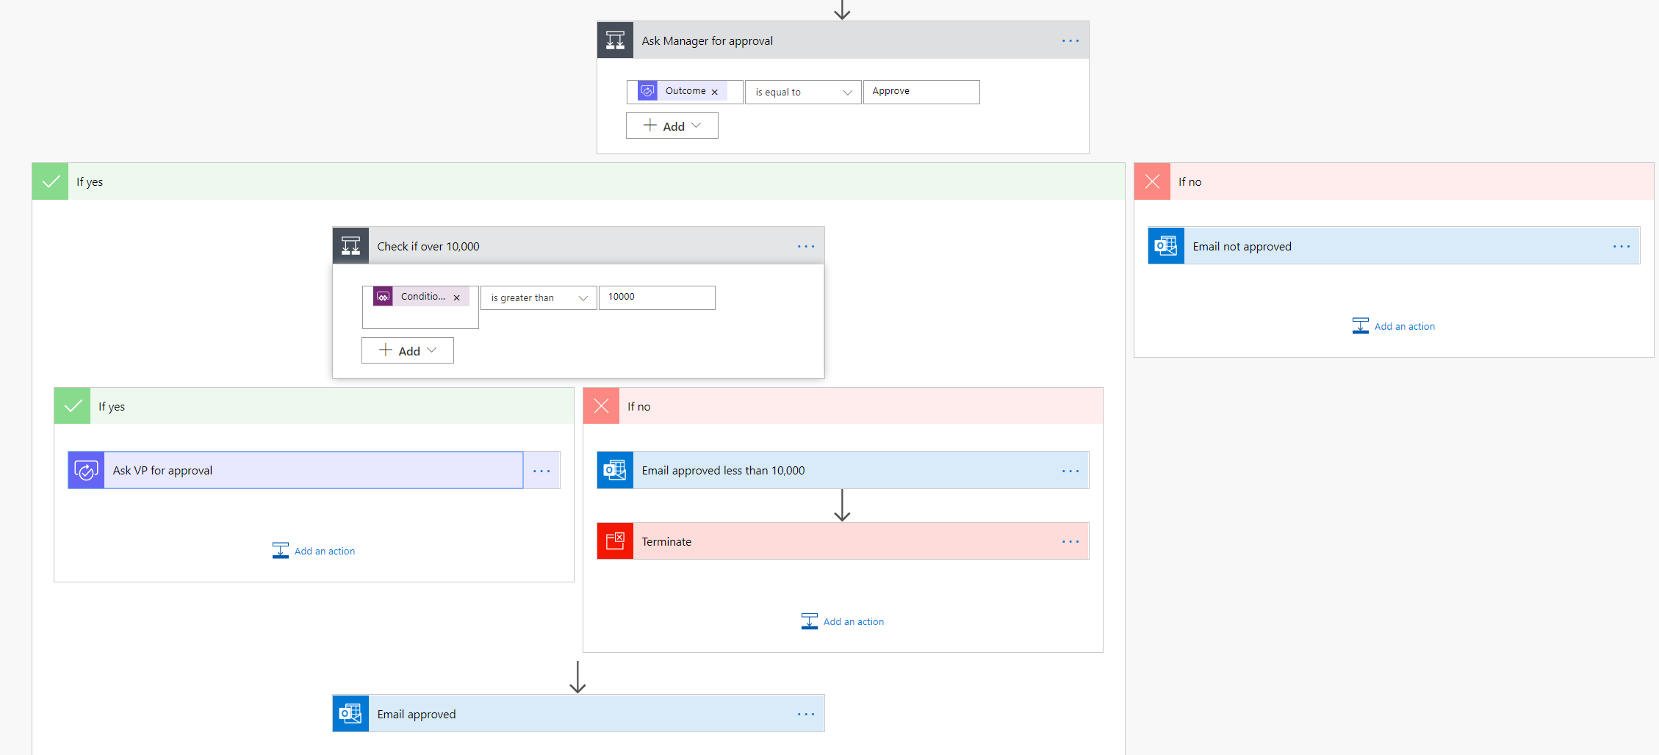
Example: Purchase order approval
Notes:
After the manager receives the approval and approves, the flow can then provide conditional logic. Typically this might be something like if the purchase order request is greater than $10,000 send it to VP if not then automatically approve the purchase order.
Here is an example of what this flow may look like.

Slide 22
Example: A purchase order approval—continued
After the manager receives the approval and signs it off, the flow can provide conditional logic. For example, this might occur when a purchase order request is greater than $10,000, so it should be sent to the VP for approval. For lesser amounts, there could be automatic approval of the purchase order.
Here’s an example of what this flow may look like.
Notes:
As you can see, even the business process has many decision points. Your flow easily handles the decisions without you writing any code.

Slide 23
What Power Automate offers
Intelligent automation for all
Automation
at scale
Seamless, secure integration
Accelerated
productivity
Intelligent
automation
Efficiently scale automation across your organization
Allow everybody in your organization to automate workflows using their favorite on-premises and cloud-based apps and services. From end users to professional developers, and IT.
Securely integrate automation at
every level
Confidently enable end users to build automated workflows in a secure, compliant manner. Focus your skilled IT resources on more complex, strategic work.
Accelerate productivity and focus on more strategic work
Minimize repetitive, manual, time-consuming tasks and create more time for your teams to focus on strategic work with easy-to-use low-code/no-code tools, templates, and connectors.
Increase efficiency through automated workflows with the power of AI
Streamline how you work by combining the power of AI with automated workflows and business processes.
Notes:
Manual, repetitive, and error-prone tasks are a drag on the strategic thinking needed to drive my business forward. To improve business processes, organizations need an efficient way to scale automation across my organization.
Some of the ways they can do this in Power Automate is by using Microsoft’s cloud services and a combination of digital process automation (DPA) and robotic process automation (RPA) in one single automation platform. Key capabilities include:
Automate legacy software using bots and screen scraping (without APIs), with SaaS-based RPA.
Automate across your widely used first- and third-party apps and services (275-plus) without APIs.
Power Automate is an end-to-end platform for data integration across on-premises software and cloud services.
Integrate your data from Dataverse to get a holistic view across your business.
Natively integrates with Microsoft’s three largest cloud services: Azure, Microsoft 365, and Dynamics 365.
Capitalize on cost-effective pricing for individuals and teams that scales to your needs.
DPA enables everyone to do their jobs without having to wait for information or request additional access.

Slide 24





Types of Power Automate flows
Automated flows
Instant
flows
Scheduled
flows
Business Process flows
Desktop
Notes:
Event driven flows - These are flows that you build with a trigger and then one or more actions. There are a multitude of triggers and actions available, thanks to the existing connectors. You will see these as My flows and Team flows in Power Automate. The only difference between a My flow and a Team flow is ownership. With a My flow you are the sole owner, while a Team flow has more than one owner.
Business process flows - These flows are built to augment the experience when using Model-driven apps and the Microsoft Dataverse. Use these to create a guided experience in your Model-driven apps.
UI flows - These robotic process automation (RPA) flows allow you to row yourself performing actions on your desktop or within a web browser. You can then trigger a flow to perform that process for you. You can also pass data in or get data out of the process, letting you automate even "manual" business processes.

Slide 25



Key concepts
A Trigger: The starting action of the flow such as new email arriving in your inbox or a new item being added to a SharePoint list.
Actions: What you want to happen when a trigger is invoked such as start the action of creating a new file on OneDrive for Business.
Conditional Logic: Defines the logic that will influence how actions are performed.
Notes:
Other examples of actions include sending an email, posting a tweet, and starting an approval.

Slide 26
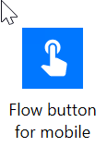
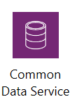
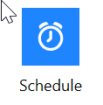

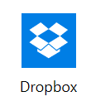


Types of triggers
Instant flows
Scheduled flows
Automated flows
PowerApps Triggered
Notes:
These are examples of the types, there are hundreds of triggers
Instant Flows, AKA button Flows are flows that are triggered by the user on demand either by clicking a button or selecting a record for it to run

Slide 27
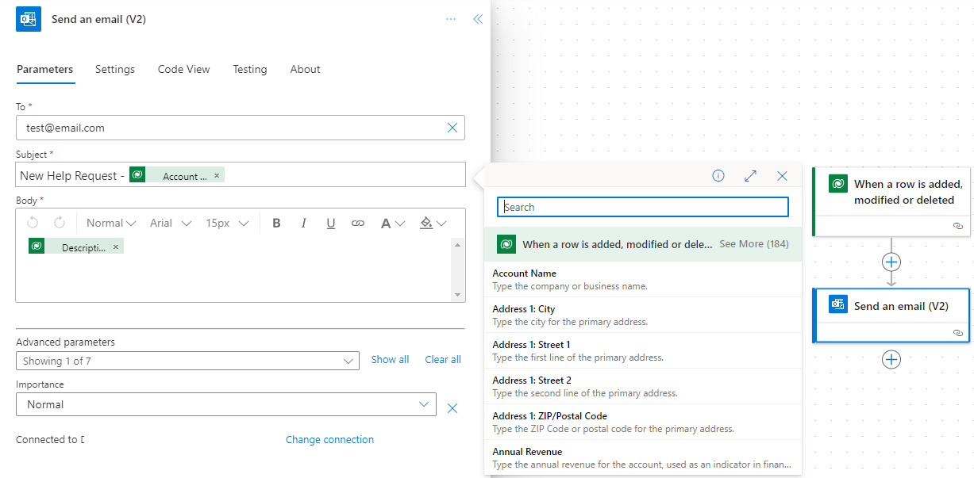
Dynamic content

Slide 28
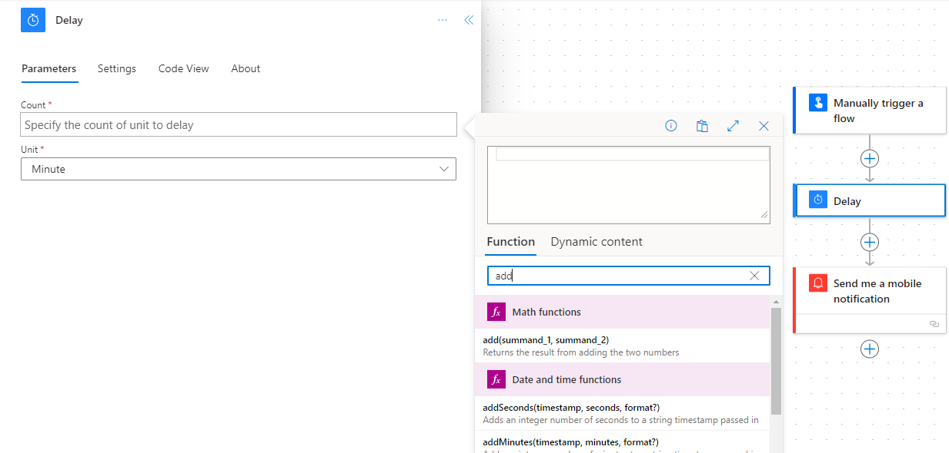
Expressions
Notes:
Many reasons to use expressions:
Convert types
Perform simple, inline calculations
like string manipulation or arithmetic,
or date/time manipulation
Generate data like the current
time, a GUID or a random number
Handling optional values
“If” conditional statements / control flow
Working with lists

Slide 29
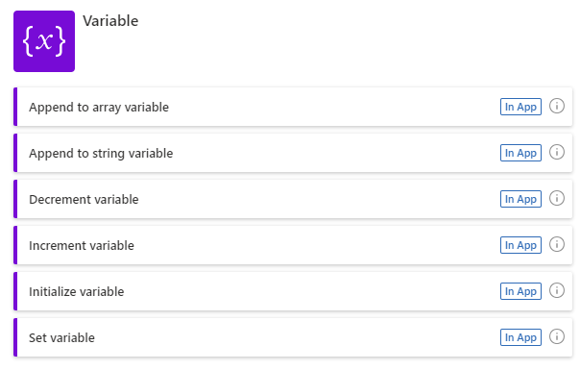
Variables
Potential use cases:
Counters – you can increment or decrement variables
Append to arrays or strings
Set state, check it elsewhere in the flow
Simplify expressions – no need to keep checking object?[‘p1’]?[‘p2’]?[‘p3’]
Notes:
Why
Useful for:
Counters – you can increment or decrement variables
Append to arrays or strings
Set state, check it elsewhere in the flow
Simplify expressions – no need to keep checking object?[‘p1’]?[‘p2’]?[‘p3’]
increment/decrement can be in any quantities, i.e. they are not like +-1, they can be used to add/subtract.

Slide 30
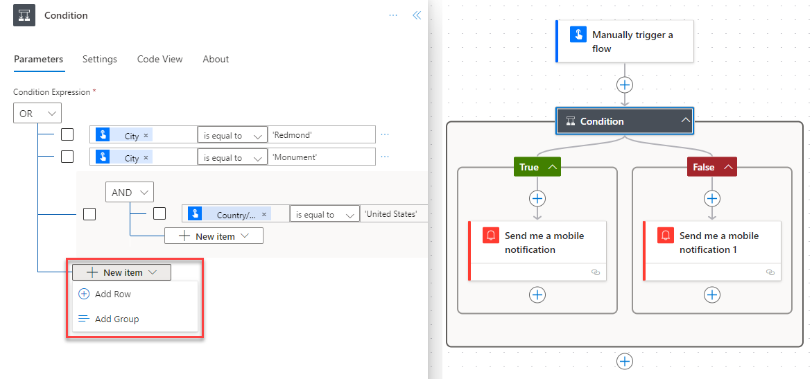
Using Conditions
Evaluates if condition is true (Yes) or false (No) and execution continues with actions in the selected branch
Can create complex criteria using grouping of conditions
Yes or No branches can contain nested condition checks

Slide 31
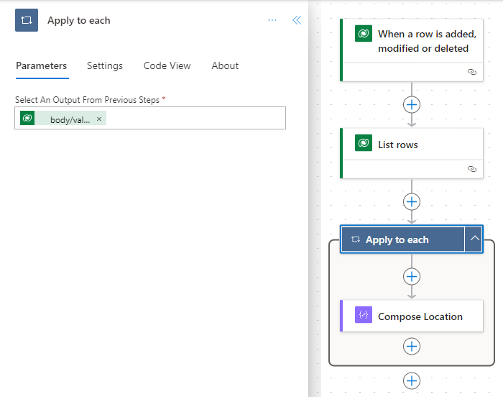
Using Apply for each
Sets of data (arrays of records) are outputs from action steps that result in multiple records e.g. Get list of records
If you reference a field from a prior step that is part of an array flow will automatically wrap it in an Apply for each
Notes:
Apply can be concurrent while Do Until is always sequential.

Slide 32
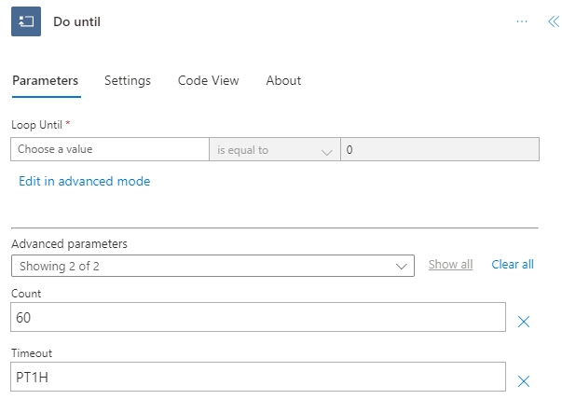
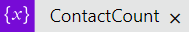
Using Do Until
Executes the actions, then checks the condition to see if it loops again – will always run at least once
Notes:
Use as a discussion slide - explain what it is doing ask how many they think will be created – then show them only 60 due to limit – they should always look at limits – and then show them the limit here

Slide 33
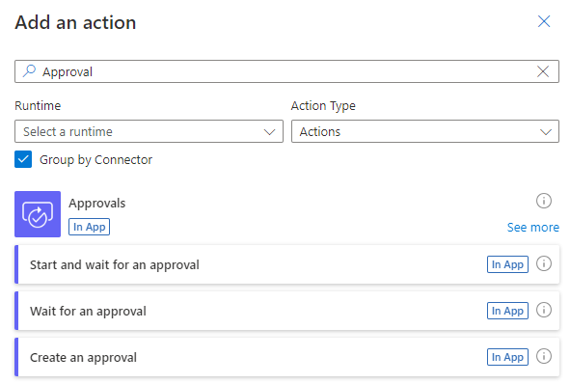
Using Approvals
Add approvals into flows using the built-in approval action
Users can approve them from email, the Approval center, or the Power Automate app
Approval scenarios
  Single approvals
  Sequential approvals
  Parallel approvals
  Everyone must approve
Notes:
More on approvals here - https://docs.microsoft.com/en-us/power-automate/get-started-approvals

Slide 34
Build basic Power Automate flows

Slide 35
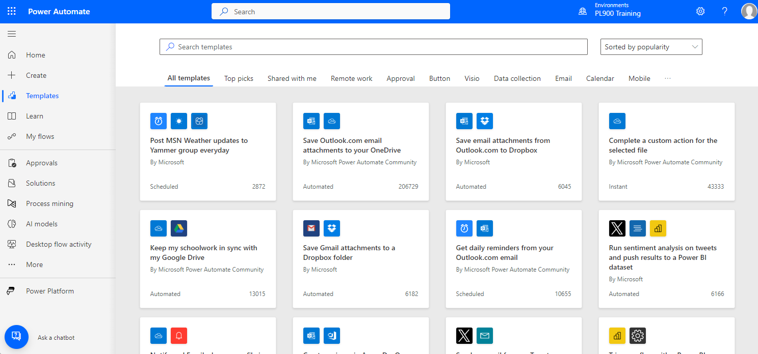
Create a flow from a template
Search using keywords for relevant templates.
Example template: Create a flow to save email attachments to OneDrive for Business.
Notes:
Power Automate has hundreds of triggers, actions, and connectors, so sometimes the hardest part is figuring out where to start. Fortunately, there are countless flow templates available to help you build a solution. To see all of the available templates sign in to Power Automate, and select Templates from the left menu.
From here, you can search by a specific word or phrase like "Common Data Service" (Dataverse) or browse based on category.
If you click a specific template, you will see more details, including the data sources it will connect to.
Create a flow to save email attachments to OneDrive for Business
From the list of templates, search for Save Office 365 email attachments to OneDrive for Business then click the template to start using it.
Click Create Flow at the bottom of the screen to create the flow.

Slide 36
Important concepts in Microsoft Power Automate
Keep these concepts in mind when building flows:
Some examples of types of actions you can have in a flow include:
  Every flow has two main parts:
  A trigger
  One or more actions
  Think of the trigger as the starting action for the flow. Actions are what you want to happen when a trigger is invoked.
  Loops
  Switch
  Do until
  Apply to each
  Expressions
Notes:
Keep these concepts in mind when building flows:
Every flow has two main parts: a trigger, and one or more actions.
Think of the trigger as the starting action for the flow. The trigger can be something like an email arriving in your inbox or a new item being added to a SharePoint list.
Actions are what you want to happen when a trigger is invoked. For example, the new email trigger will start the action of creating a new file on OneDrive for Business. Other examples of actions include sending an email, posting a tweet, and starting an approval.
Some examples of types of actions you can have in a flow include:
Loops—runs an action until conditions are met to move to the next step of the flow.
Switch—identifies a single case to execute based on the evaluation of input.
Do until—executes a block of actions until a specified condition evaluates to true.
Apply to each—executes a block of actions for each item in the input array.
Expressions—underlying definition that describes the actual logic that runs in your flow that can be manually written.
You can also do data operations in your flow, such as Compose, Create CSV table, Join, or Select. These concepts will come into play later when you build your own flows from scratch.

Slide 37
Trigger or run the flow
With Power Automate, you don’t think of running a flow the same way as you do with Power Apps. Instead, you do the activity that triggers the flow to run.
  When defining triggers, there are a few different types:
When something changes:
These are triggers that run when data is changed. It could be a new item created in SharePoint, a lead updated in Dynamics, or when an event has been deleted from Outlook, for example.
On a schedule:
You can set up a flow to be triggered at a certain time of day and with a recurrence. This allows for workflows such as checking every day at 8.00 AM if there are account renewals pending and, if so, sending an email to the necessary people.
On a button press:
This trigger takes shape in many different ways. This can be when a flow virtual button is run through the mobile app, or a physical button is clicked with third-party options, or even when a button is pressed inside Power Apps. This gives you control to “run” a flow on demand.
Notes:
With Power Automate, you don’t think of running a flow the same way as you do with a Power Apps app. Instead, you do the activity that triggers the flow to run. In the case of the previous flow, instead of periodically running it manually, it would automatically run every time a new email is received with an attachment. This is because the flow has the trigger that determines when it should run.

Slide 38
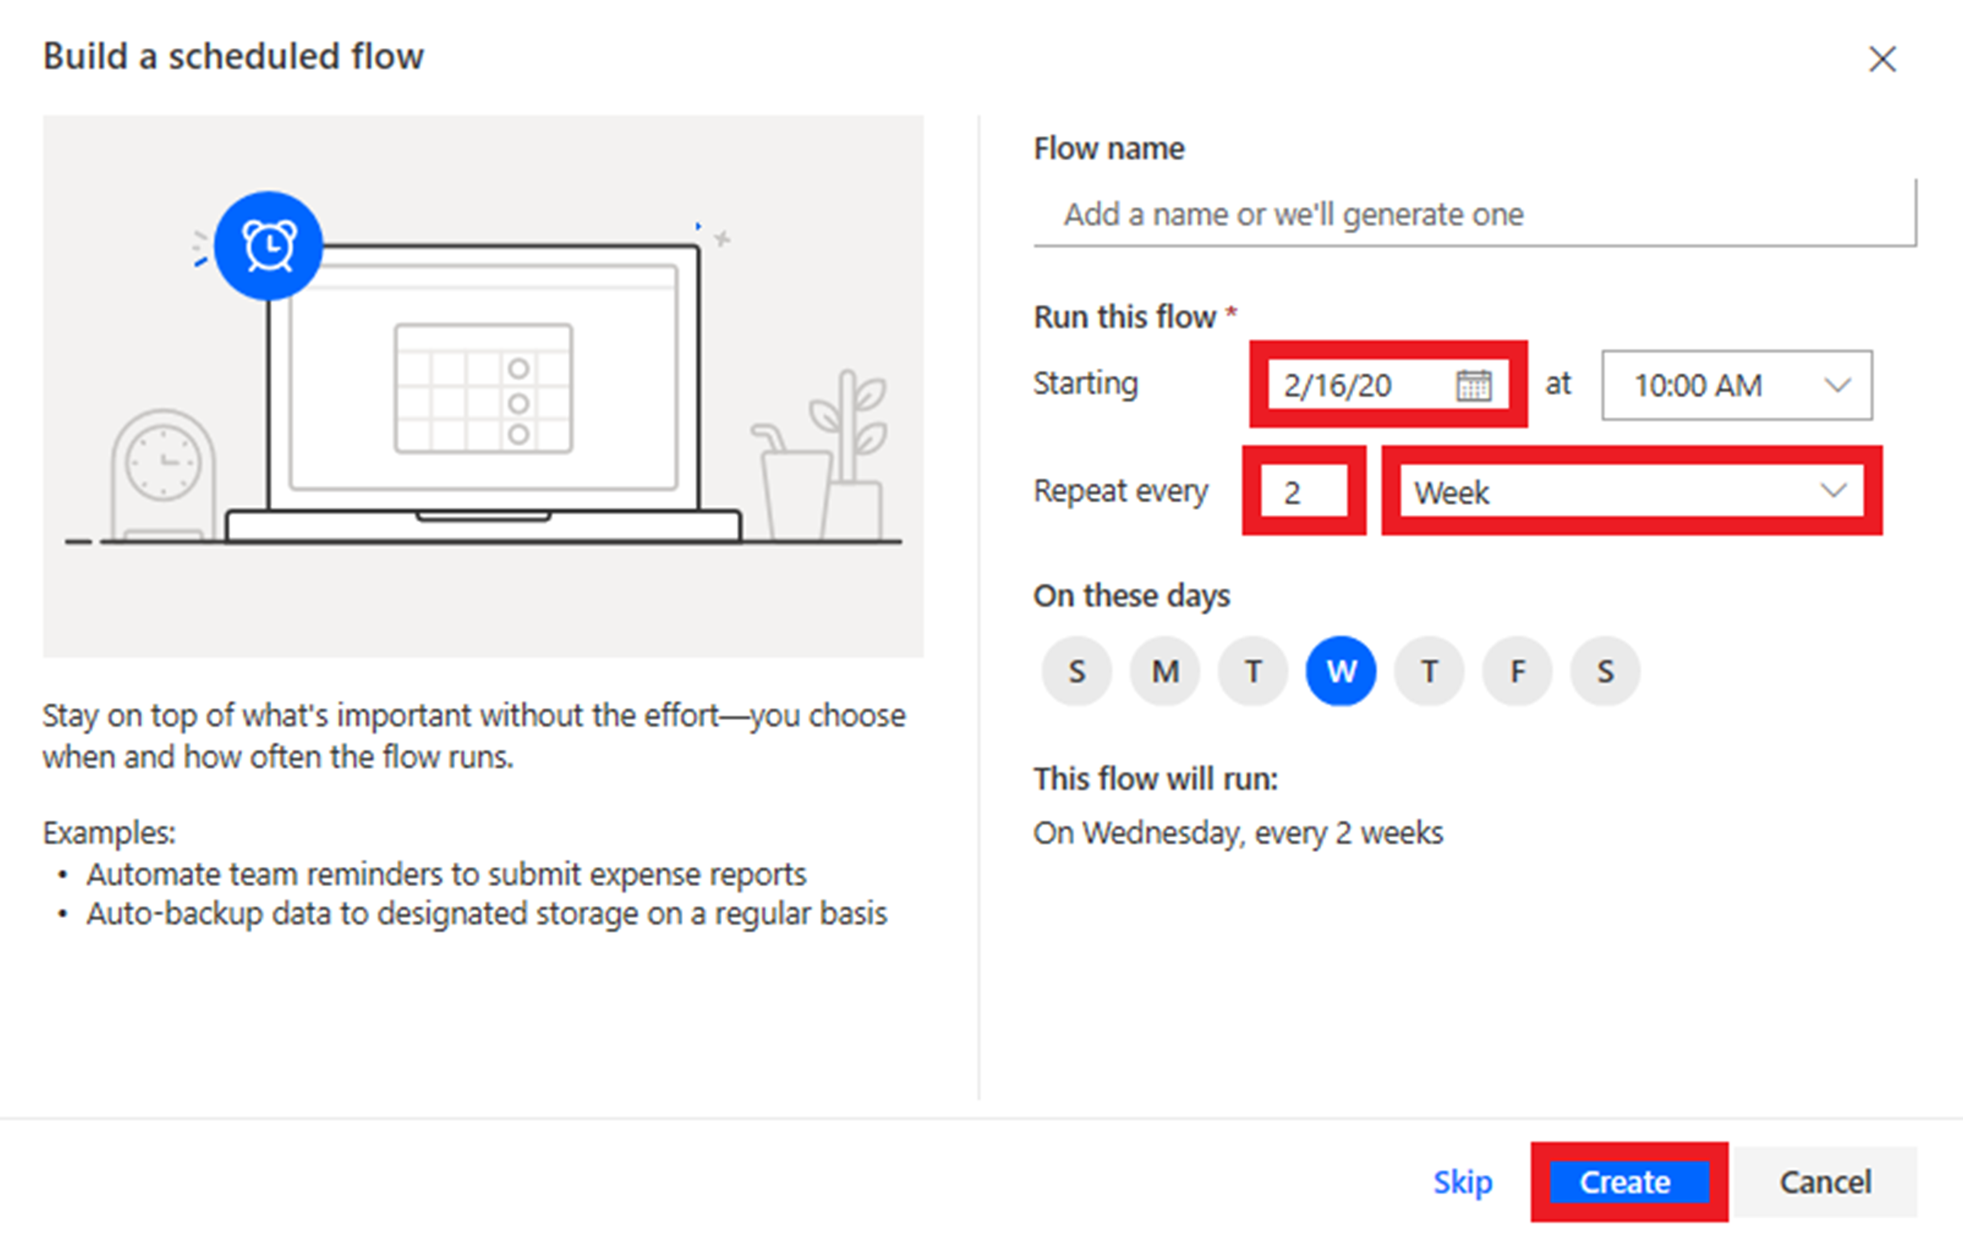
Scheduled flows
Scheduled flows can run:
Once a day, once an hour, or once a minute.
On a date that you specify.
After a number of days, hours, or minutes that you specify.
Notes:
Create the flow:
For example, if you want the flow to run every two weeks, enter 2 in the Interval field, and select Week in the Frequency field. You can also specify the day of the week your flow should run. The text at the bottom of the dialog box explains your inputs in plain language.
Specify advanced options
For example, set up the flow as shown in the following graphic to start it no earlier than noon (Pacific Time) on Monday, January 1, 2018, and to run it every two weeks, at 5:30 PM (Pacific Time) on Tuesday.
Use the compose action
Use the Data Operation - Compose (compose) action to save yourself from entering identical data multiple times when you are designing a flow.
**Follow steps on Build recurring flows - Learn | Microsoft Docs to build a recurring flow (you can do as a demo or individual exercise).

Slide 39
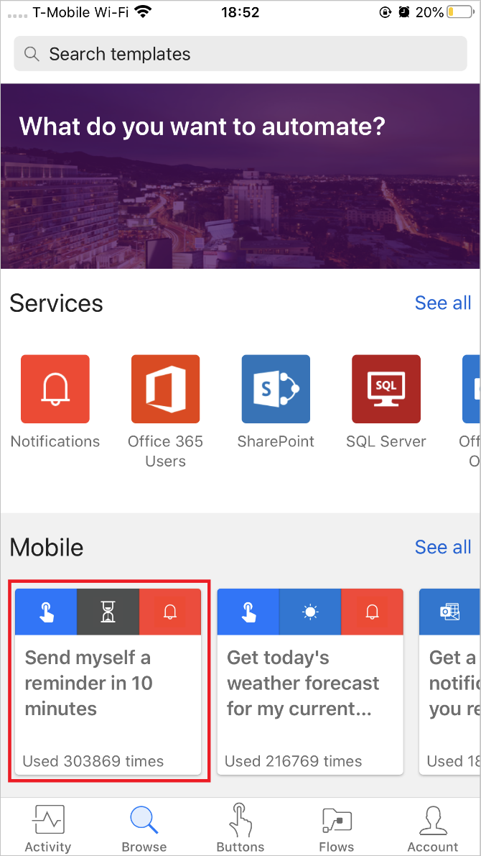
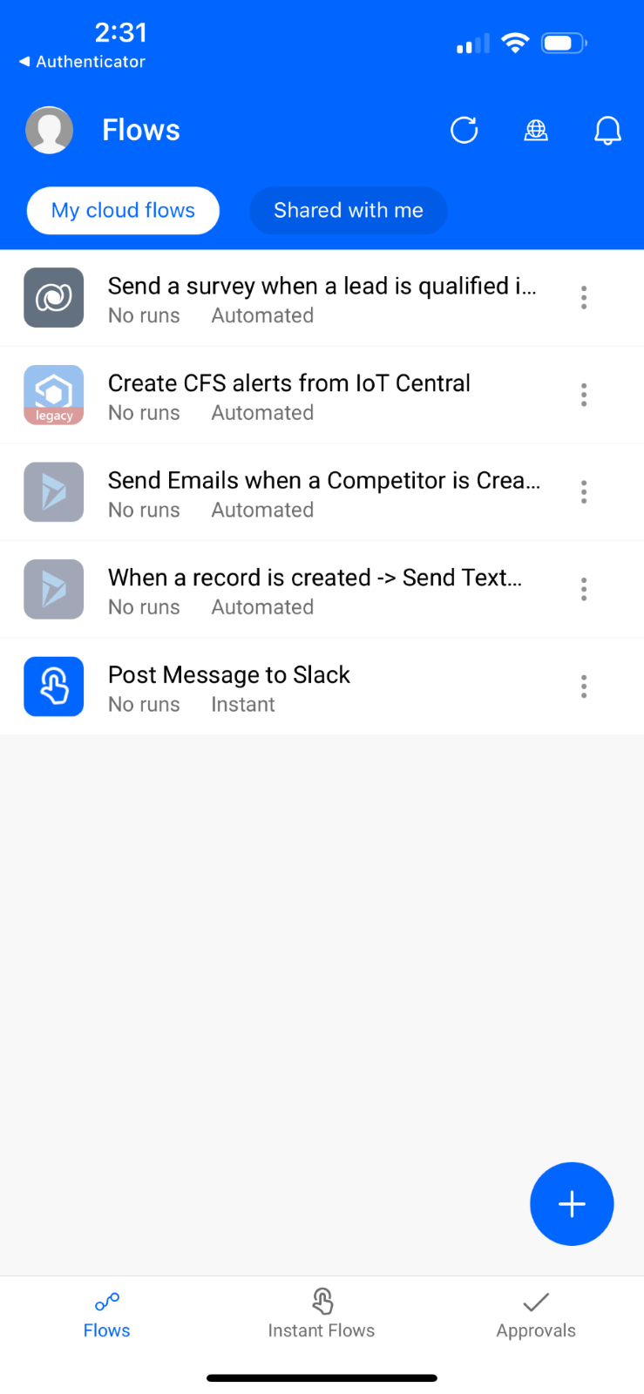
Button flows
  Create a flow using a button through the Power Automate mobile app
  Activity feed
  Browsing
  Buttons
  Managing flows
  How button flows are started
  Buttons are flows that are started through a manual action
Notes:
Create a flow using a button through the Power Automate mobile app
First, you'll need to download and install the Power Automate mobile app from your app store.
After it's installed, start it and sign in.
When you first start the app, you'll see the Activity Feed. This is where you’ll see what's happening with your flows. It won't be the full experience you'd expect from your PC, but it will show some useful details.
For example, you'll see a flow's last activity and find out whether it succeeded or failed. If it failed, you'll see where it went wrong.
**Follow steps on Build a button flow - Learn | Microsoft Docs to build a button flow (you can do this as a demo or individual exercise).

Slide 40
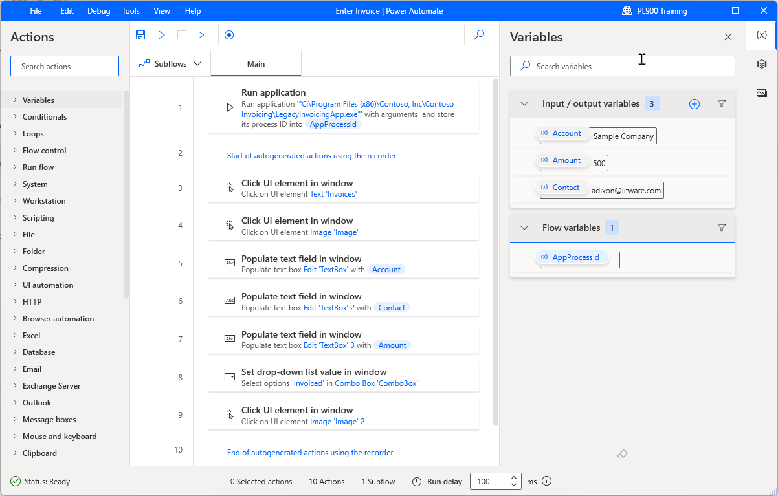
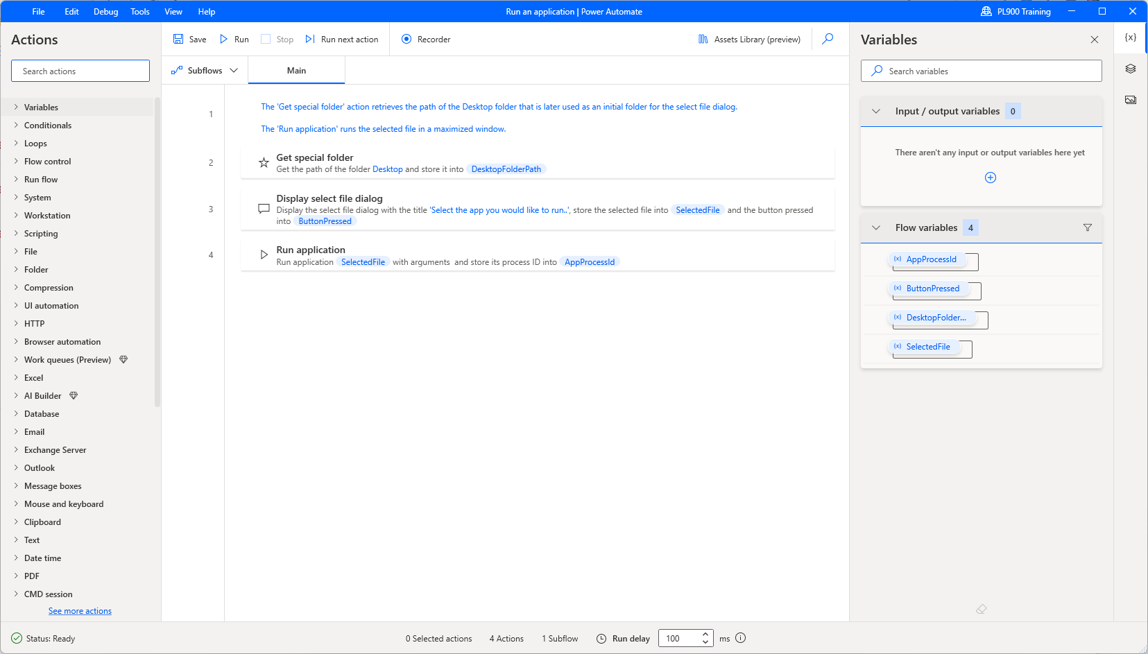
Desktop flows
Used to automate repetitive tasks where no predefined APIs are available.
Two primary types:
UI automation
Web automation

Slide 41
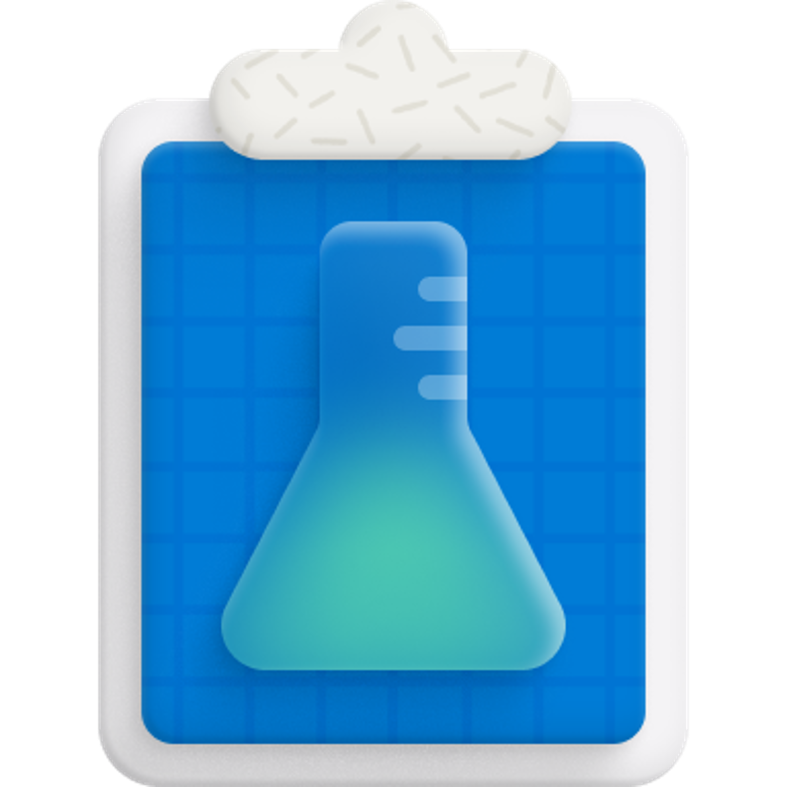
Power Automate in action
https://edxinteractivepage.blob.core.windows.net/edxpages/PL-900/20240225/m4_power_automate/index.html
Notes:
From Learn:
M4 - PA Cloud click-through
https://edxinteractivepage.blob.core.windows.net/edxpages/mb-910/m4_pa_cloud_click_through/index.html
M4 - PA Copilot click-through
https://edxinteractivepage.blob.core.windows.net/edxpages/mb-910/m4_pa_copilot_click_through/index.html
M4-DesktopFlow_Click
https://edxinteractivepage.blob.core.windows.net/edxpages/mb-910/m4_desktopflow_click/index.html

Slide 42
Test & Troubleshoot

Slide 43

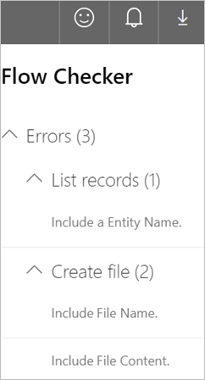
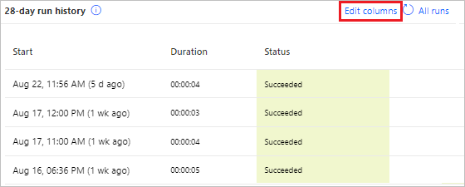
Troubleshooting a cloud flow
Power Automate is an online workflow service that automates actions across the most common apps and services
Notes:
Power Automate is an online workflow service that automates actions across the most common apps and services. For example, you can create a flow that adds a lead to Microsoft Dynamics 365 and a row in MailChimp whenever someone with more than 100 followers tweets about your company.
When you sign up, you can connect to more than 1000 services, and can manage data either in the cloud or in on-premises sources like SharePoint and Microsoft SQL Server. The list of applications you can use with Power Automate grows constantly.

Slide 44
Power Platform administration and security

Slide 45







Environments in Dataverse
Dev Environment
Dev Environment
Dev Environment
Test Environment
Test Environment
Test Environment
Prod Environment
Prod Environment
Prod Environment
Petersen International (tenant)
Environments are used to store, manage, and share your organization's business data, apps, and flows in Microsoft Power Platform.
  Each environment allows you to provision one Dataverse database for use within that environment. Dataverse environments allow you to manage user access, security settings, and the storage associated with that database.
  Each environment is created under a Microsoft Azure Active Directory (Azure AD) tenant―its resources can only be accessed by users within that tenant.
  An environment is also bound to a geographic location, like the United States. When you create a Dataverse database in an environment, it is created within datacenters in that geographic location.
Notes:
Any items that you create in that environment (including connections, gateways, flows that are using Power Automate, and more) are also bound to their environment's location.

Slide 46
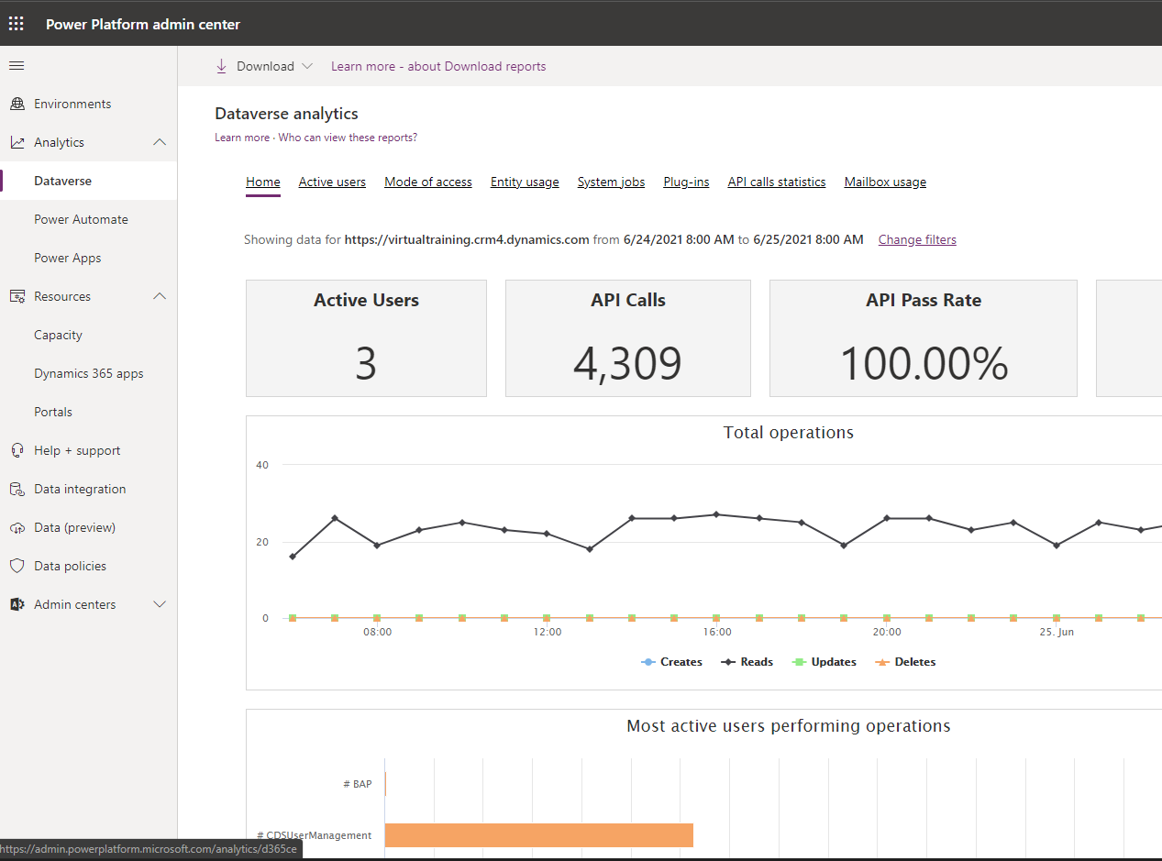
Power Platform admin center
Most of the administration settings you will need are available in the Power Apps admin center. When you look to manage Dataverse, always check for administration settings as your first step.
Settings are grouped into the following broad categories and are accessible by selecting the link on the left of the portal, as shown here.
Environments – this section lists all instances of Dataverse.
Analytics – see how resources are being used in your environment.
Resources – view and assign capacity to your environment.
Data integration – this section lets you create or add predefined connections and monitor them between Dataverse and other data stores like Salesforce or SQL Server.
Data policies – this section lets you set up policies to restrict which data connectors can be used with Dataverse to limit what data can flow in to or out of Dataverse tables.
Notes:
The Power Platform admin center provides a unified portal for administrators to manage environments and settings for Power Apps, Power Automate, and customer engagement apps (Dynamics 365 Sales, Dynamics 365 Customer Service, Dynamics 365 Field Service, Dynamics 365 Marketing, and Dynamics 365 Project Service Automation).
Environments: View, create, and manage your environments. Select an environment to see details and manage its setting. For more information, go to: https://learn.microsoft.com/en-us/power-platform/admin/admin-settings
Analytics: Get a detailed view of key metrics for Microsoft Power Platform apps. For more information, go to: https://learn.microsoft.com/en-us/power-platform/admin/analytics-common-data-service
Resources: For more information, go to: https://learn.microsoft.com/en-us/power-platform/admin/view-manage-resources
Help and support: Get a list of self-help solutions or create a support ticket for technical support. For more information, go to: https://learn.microsoft.com/en-us/power-platform/admin/get-help-support
Data integration: For more information, go to: https://learn.microsoft.com/en-us/power-platform/admin/data-integrator
Data gateways: For more information, go to: https://learn.microsoft.com/en-us/power-platform/admin/onpremises-data-gateway-management
Data policies: For more information, go to: https://learn.microsoft.com/en-us/power-platform/admin/create-dlp-policy

Slide 47
Power Platform data connectors

Slide 48
Data connectors
Connectors are available for use in multiple products:
Custom connectors:
Power Automate
Power Apps
Logic Apps
An advantage of building custom connectors is that they can be used in different platforms, such as Power Apps, Power Automate, and Azure Logic Apps.
This allows you to extend an app by calling a publicly available API, or a custom API you're hosting in a cloud provider, such as Azure.
You create custom connectors using three different approaches:
Using a blank custom connector.
From an OpenAPI definition.
From a Postman collection.
Notes:
Microsoft Power Platform gets its power from an ability to leverage data across many platforms. To do this, Microsoft Power Platform components use connectors. Think of connectors as a bridge from a data source to your app or workflow which allows information to be conveyed back and forth. You use connectors to extend your business solutions across platforms and add functionality users. Microsoft Power Platform has more than 275 connectors with the ability to also build custom connectors.
It’s important to note that you’ll need a paid plan to use premium connectors. The connector reference in the Summary and Resources unit lists all connectors and shows whether they’re considered standard or premium. Custom connectors are also considered a premium feature.
Both these data source types are commonly used to bring data and additional functionality to your solutions.
As you can see, connecting to data sources allows you to integrate disparate parts of your business solutions to build them out cohesively.
Tabular data: A tabular data source returns data in a structured table format. Power Apps can directly read and display these tables through galleries, forms, and other controls. Additionally, if the data source supports it, Power Apps can create, edit, and delete data from these data sources. Examples include Dataverse, SharePoint, and SQL Server.
Function-based data: A function-based data source uses functions to interact with it. These functions can be used to return a table of data but offer more extensive action such as the ability to send an email, update permissions, or create a calendar event. Examples include Office 365 Users, Project Online, and Azure Blob Storage.
Triggers are only used in Power Automate and prompt a flow to begin. Triggers can be time-based, such as a flow which begins every day at 8:00 AM, or they could be set around an action like creating a new record in a table, or receiving an email. You’ll always need a trigger to tell your workflow when to run.
Actions are used in Power Automate and Power Apps. Actions are prompted by the user or a trigger and allow interaction with your data source and a function. For example, an action would be sending an email in your workflow or app, or writing a new line to a data source.

Slide 49
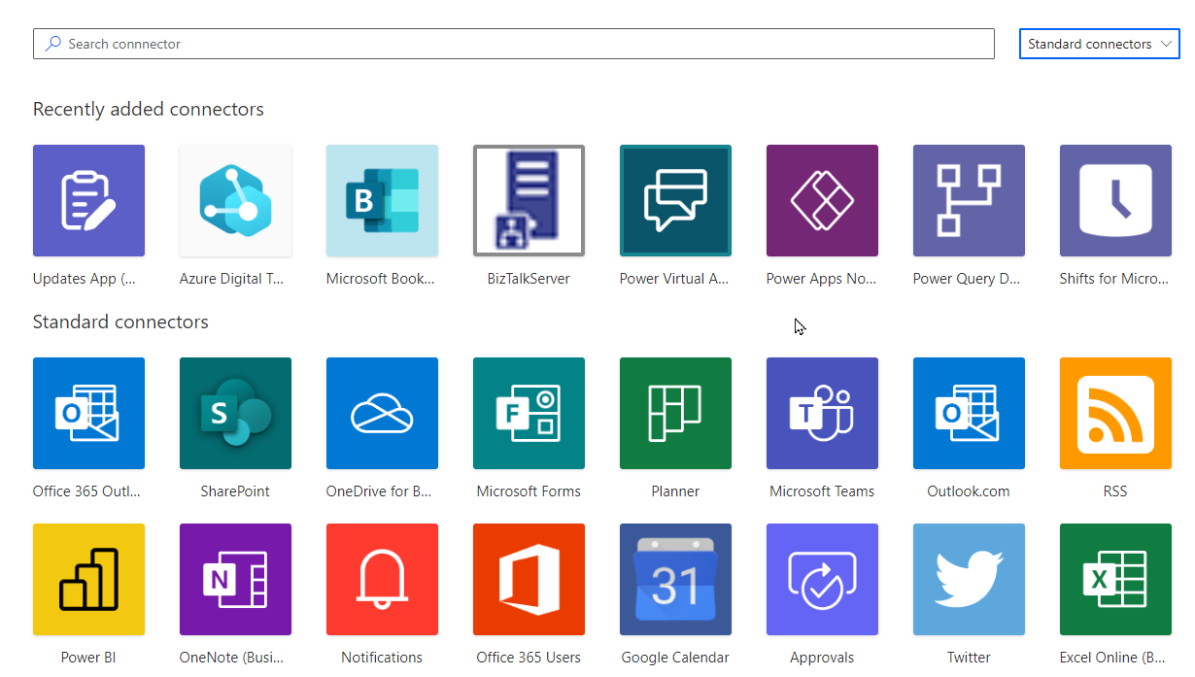
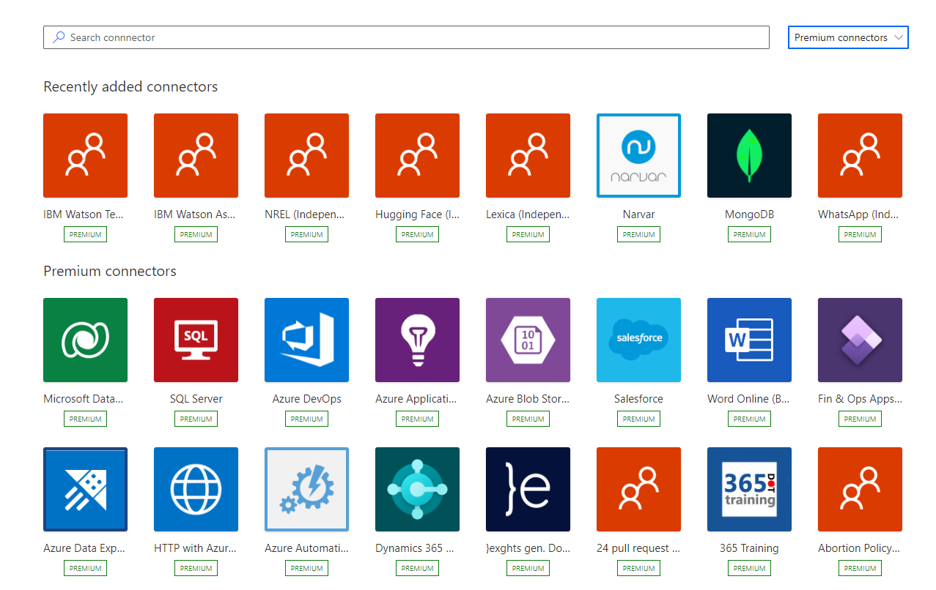
Standard vs Premium
Standard connectors are included in your standard Microsoft 365 subscription:
Premium connectors available when you have the appropriate standalone plans:
Notes:
Standard connectors
Standard tier connectors are included in your standard Microsoft 365 subscription. Standard connectors cover many of the most used data sources such as SharePoint, OneDrive, and Power BI as well as third-party data sources such as Google Drive, Twitter, GitHub, and more.
Premium connectors
While standard connectors are available with a standard Microsoft 365 subscription, premium connectors are only available when you have the appropriate standalone plans such as Power Apps per user plan, or a Power Automate per user plan. The main advantage of premium connectors is that they allow you to connect to a larger number of services. Most premium connectors cover external applications such as Salesforce, DocuSign, Survey Monkey, Amazon, and so on. There are several Microsoft applications that use premium connectors such as Dynamics 365. Premium connectors are identified by the premium stamp.

Slide 50
Get started with Power Automate Desktop

Slide 51
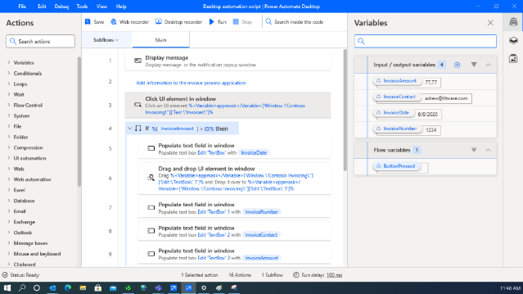
Power Automate Desktop
Low-code/no-code drag & drop approach with recorders (desktop and web)
Advanced error handling and debugging
Reusability of controls, images and functions
Support for advanced coding-scripting
(VBScript, JavaScript, Python, PowerShell,
Command Line)
Attended and unattended execution mode
Concurrent process execution
Notes:
When you launch Power Automate for desktop, the first window that appears is the Home screen. This screen is where you give a quick overview of all the new features available.
When you select My flows, you see the console. The console is the main component of the platform from which you can manage your existing flows and launch the flow designer to edit them or create new ones.
When you select an existing flow, you get a new command bar with bulk actions you can perform.
Like all products in Microsoft Power Automate, the Power Automate for desktop console enables you to select a development environment, handle all the flows in it, and create new ones.
Note
Environments are spaces to store, manage, and share your organization's business data, apps, chatbots, and flows. They also serve as containers to separate apps that might have different roles, security requirements, or target audiences.
To handle an existing flow, right-click on it and choose between starting, editing, renaming, and deleting it. If the flow is currently running, one more option to stop it is available.
To run, stop, or edit a flow more efficiently, you can use the icons next to its name.
In Examples, you'll see several categories you can have available to use as templates.
Each category shows how many examples there are. For example, Excel Automation has 5.
Select Excel Automation to see all of the examples that you can use.

Slide 52
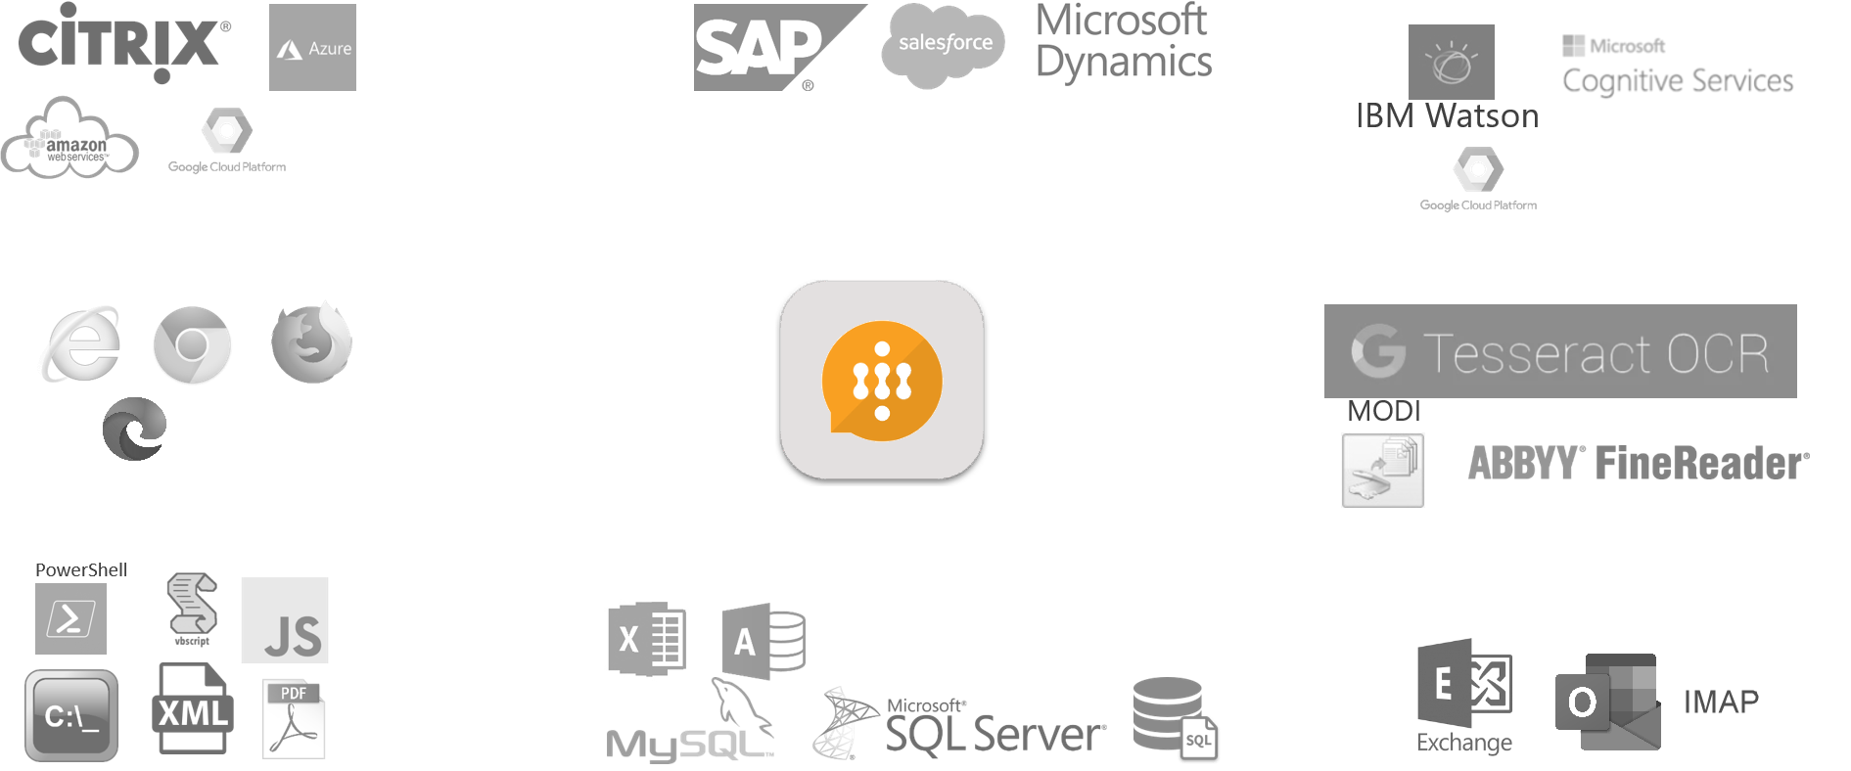

Includes hundreds of actions
Web - desktop applications
Citrix and VDI Environments
Cloud automation (Microsoft Azure, Amazon AWS) and Cognitive capabilities (IBM, Google, Microsoft)
Databases-SQL Excel
PDF & XML
Files, folders and mouse-keyboard
Email (IMAP, smtp, exchange, outlook)
Encryption – cryptographic actions, CyberArk support
OCR for structured and unstructured data capturing and handling
Cloud / virtualization
Cognitive
Web automation
OCR
Scripting - Systems
Databases
Emails
Notes:
Power Automate Desktop Includes almost 400 actions covering all users needs and are available for use in UI flows

Slide 53
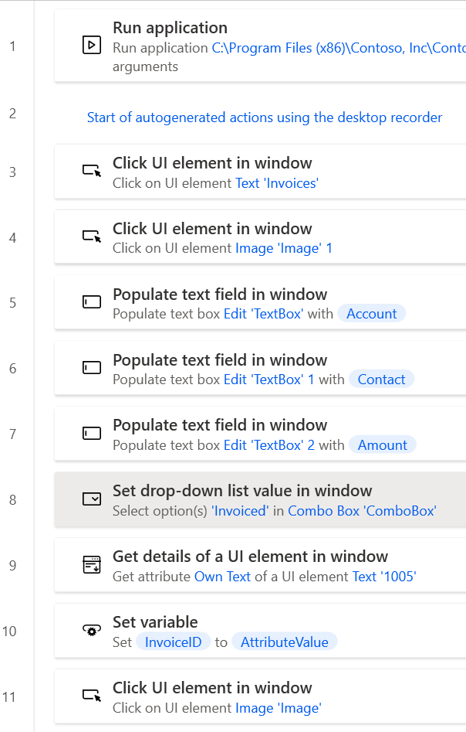
Edit Actions
Drag and drop to re-order
Copy and paste supported
Disable steps
Edit properties on action steps
Select multiple steps

Slide 54
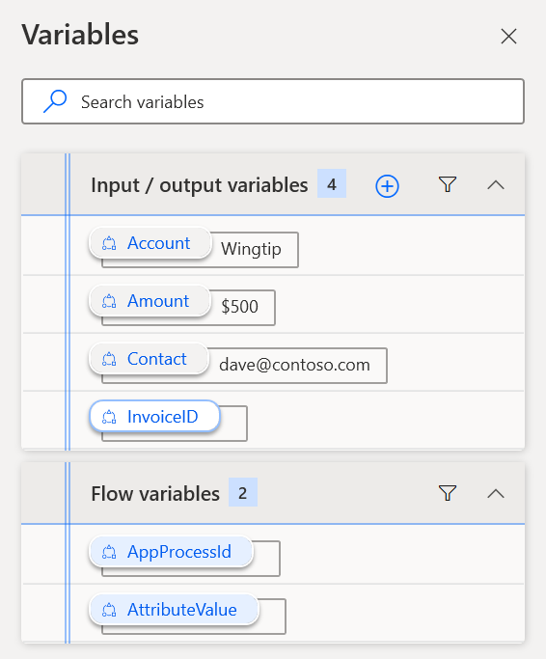



Variables – Input, Output and Flow
Use Input variables to pass dynamic data into the flow steps
Use Output variables to make outcomes available
Use Flow variables to hold values between steps

Slide 55
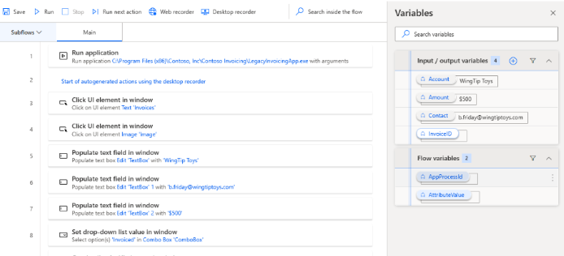
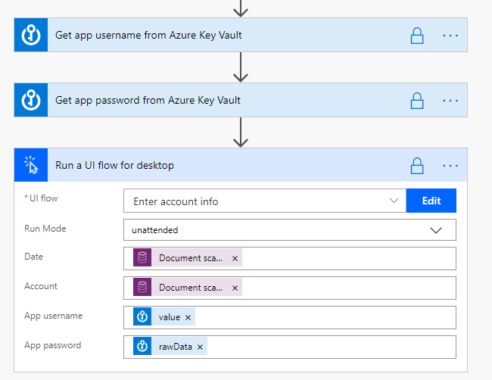
Using Inputs and Outputs
Define inputs/outputs in UI flows
Bind them in the flow that runs the UI flow

Slide 56
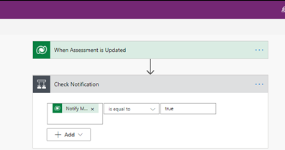
Key concepts
Every flow has two main parts:
A Trigger
The starting action of the flow such as new email arriving in your inbox or a new item being added to a SharePoint list
One or more Actions
What you want to happen when a trigger is invoked such as start the action of creating a new file on OneDrive for Business
Trigger
Action
Notes:
Other examples of actions include sending an email, posting a tweet, and starting an approval.

Slide 57
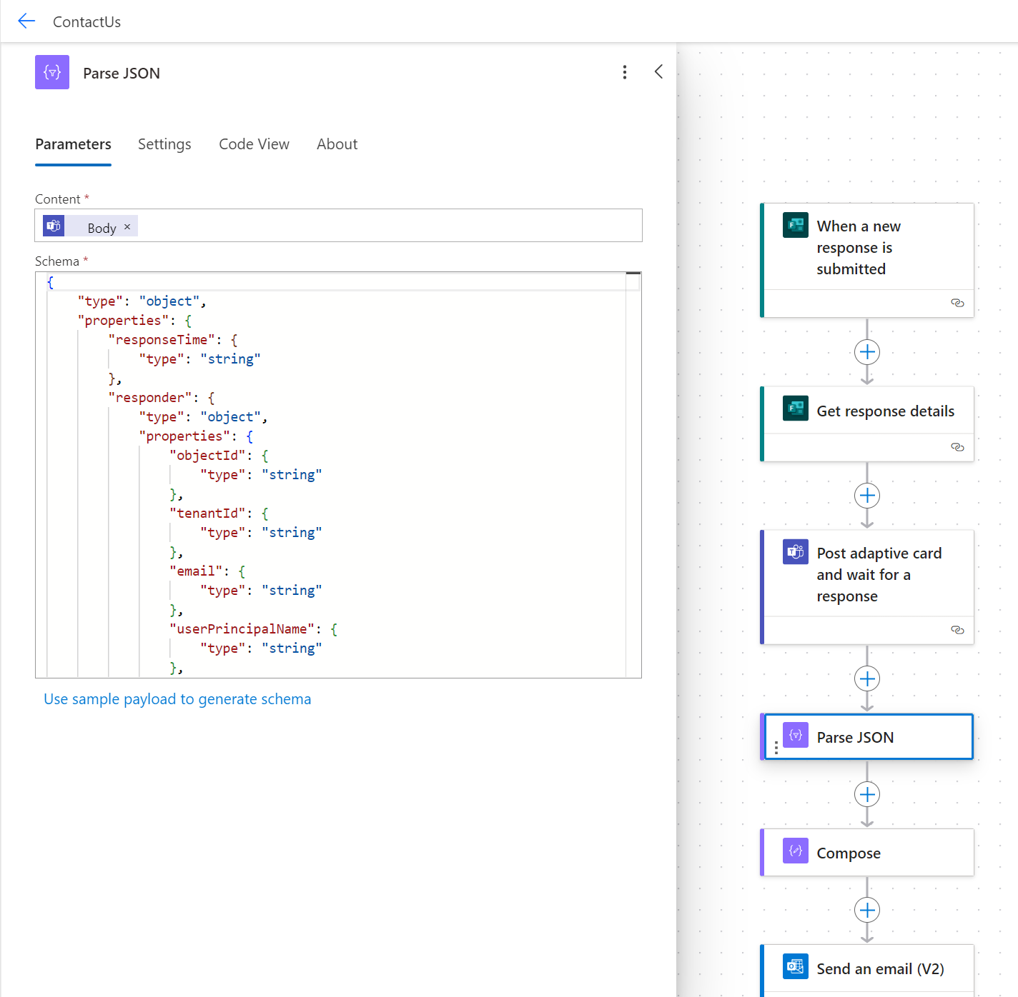

Slide 59
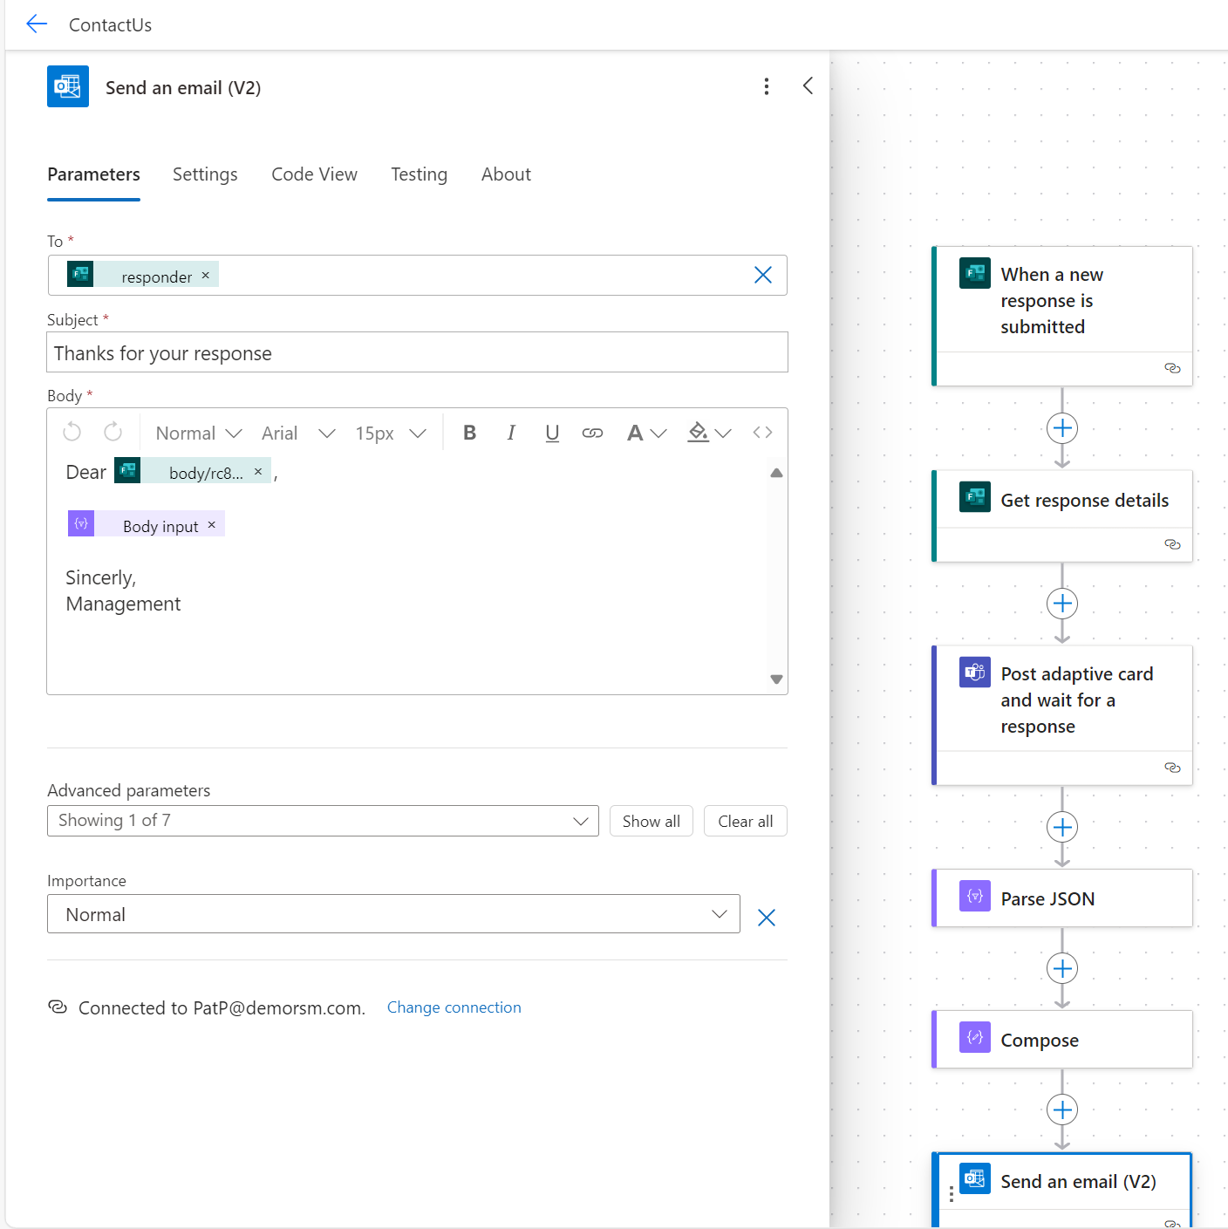

Slide 61
1 2 3 4 5 6 7 8 9 10 11 12 | { "type": "AdaptiveCard", "$schema": "http://adaptivecards.io/schemas/adaptive-card.json", "version": "1.5", "body": [ { "type": "TextBlock", "text": "I'm a simple text block", "wrap": true } ] }
Digging deeper, this is an interesting “fix” due to Microsoft documentation stating that Teams does in fact support version 1.5, but it’s very easy to reproduce the issue:
Create an Instant Flow that uses the “Post adaptive card in a chat or channel” action
Choose “Post as: Flow bot”
Choose “Post in: Chat with Flow bot”
Add yourself as the recipient
Use this schema for a very simple card that is using version 1.5
After running the flow, you should see the error, “We’re sorry, this card couldn’t be displayed” when the message posts to your chat. To fix the issue, go back and edit the flow and change the version from “1.5” to “1.4” and re-run; at this point, you should see the card displays correctly.
One other piece of information worth noting is that if you’re using Bot Framework Composer to send adaptive cards with a version of 1.5, instead of seeing the error message, you’ll find that your card simply doesn’t appear at all, but once again, changing to version 1.4 should resolve your issue.

Slide 62
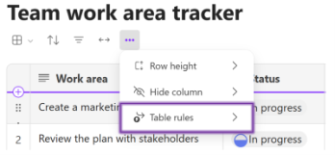
Using Loop
How it works
1. Go to loop.microsoft.com.
2. Select a table-based component in an existing Loop page or create one.
3. Select the ellipses menu, and then select Table rules.

Slide 63
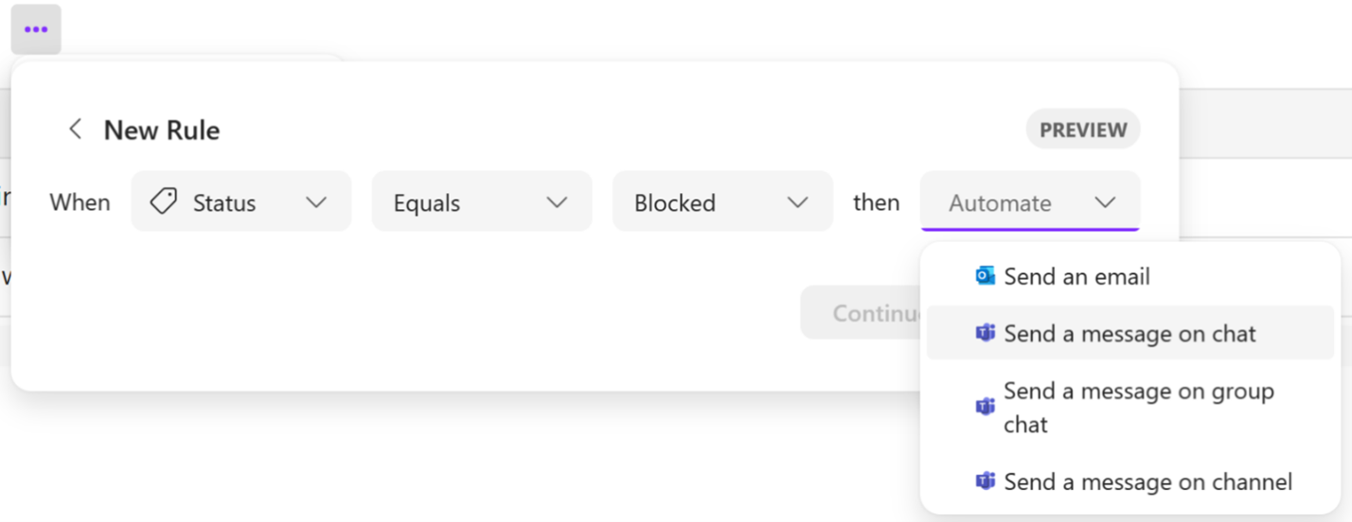

4. Set your desired trigger, condition, and action, and then select Continue.
5. Review the apps that your rule uses and select Next.

Slide 64

6. Add the recipients and select Create flow.
NOTE: Each automation rule in Loop corresponds to a flow in Power Automate. Limits on rule creation and execution will be determined by your Power Automate license.

Slide 65
Questions

Slide 66
Thank you

