Slide 1



Empowering Collaboration and Streamlining Productivity: Leveraging Automation in Microsoft Teams
April 15, 2025
Pat Petersen
Director | MCT
RSM US
PatPetersen.com
@prpetersen
https://www.linkedin.com/in/patrick-petersen-mn/
Notes:
PPT Template by Eric Marsi
Yes, attendees get access to the slides after the event.

Slide 2
Agenda
Introduction
Sponsors
Q&A

Slide 3



Thank You to Our 2025 PLATINUM Sponsors!
We would also like to thank all our Gold, Silver, Supporting, & Digital Sponsors for your support!

Slide 4
Introduction

Slide 5


About Me – Pat Petersen
Director – Collaboration and Voice
- Microsoft Certified Trainer since 2011
- Community Speaker since 2012
- Love OOTB technology
- Owner of a 1975 AMC Pacer
PatPetersen.com
@prpetersen
https://www.linkedin.com/in/patrick-petersen-mn/
Notes:
Create a copy of this slide if you have a co-presenter

Slide 6
Challenges

Slide 7
Business and IT challenges
Difficulty scaling development efficiently
Budget, time and resource constraints
Rising customer expectations
Paper processes
Change in workforce expectations
IT/business partnership
Customer need for
agile solutions
Need for differentiation
Developer supply falling behind demand
Security and
compliance risks
Notes:
What prevents us from doing our best work, even with all of the technology and data at our disposal?
Our research shows that information workers use an average of 36 different cloud services at work – which create many sources of distraction. In fact, three minutes is the average time workers spend on a single task before being interrupted, and it takes an average of 25 minutes for them to return to their original task. In addition to these distractions, the growth of cloud app usage within organizations - including unsanctioned apps like WhatsApp, the cornerstone of unintended digital transformation - has driven our customers to act to both eliminate shadow IT and consolidate vendors. (1)
Critical line of business systems are sources of lost productivity, as these systems rarely communicate with each other, and that fractured flow of information causes to spend more time doing low value work. Think about the amount of effort that submitting expenses or opening a purchase order takes in contrast to the value that that effort adds. Then think of that on an organizational level: How much time is spent manually taking information from one system and entering it into another?
And in terms of enabling transformation, security and compliance risk is the most important consideration, as customer trust and IP is paramount. But we see customers make decisions based off of security that have counterintuitive outcomes: restrictive policies lead employees to use non compliant apps, and “best of breed” approaches leave companies with an average of 70 security products from 35 vendors (2), which adds complexity and prevents the ability to respond quickly.
The underlying cause of these challenges to productivity is that innovation in digital transformation has been focused on developing new apps and services that leverage the increasing the amount of data we can access. As a result, we use lots of apps, we have critical line of business systems that don’t talk to each other, and we have lots of security products to solve singular needs. The resolution to these challenges is shifting the focus of transforming how we work from an app and tool based approach to a human-centric approach, where technology serves the purpose of helping people accomplish more without doing more.
Sources
(1) The Future of Work https://query.prod.cms.rt.microsoft.com/cms/api/am/binary/RE2MfkH
(2) Nick McQuire, VP Enterprise Research CCS Insight

Slide 8
Digitize manual processes
Common challenges
Teams can help you
Unsanctioned shadow IT fills current communication gaps while cultural barriers limit new technology rollout & adoption
Workforce efficiency
Improve workforce flexibility and respond quickly with Walkie Talkie
Improve coordination between business functions and frontline teams with Tasks and task publishing
Fragmentated systems, tools & business processes that are often manual and redundant
Resource optimization
Provide integrated solutions that improves profit margins and operational efficiency with Teams as a platform
Constant need to have visibility into on-the-ground operations
Inventory shrinkage
Optimize business processes thru data-driven insights and automation of routine tasks and processes with Power BI and Power Apps like Inventory Management

Slide 9
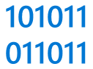
Increase operational efficiency
Digitize manual processes
Gain operational visibility
Be agile in dynamic environments
Notes:
First, we are going to check out how Teams can help digitize manual processes <click>

Slide 10
Digitize manual processes
Challenges
Inefficient and disorganized manual processes
Fragmented experience with multiple siloed tools
Little integration between different systems and processes
Notes:
Challenges faced by the frontline include
Inefficient and disorganized manual processes that are often critical but take time away from other value add activities.
Fragmented experience with multiple siloed tools and little integration between different systems and processes – making it harder to switch between different workflows quickly and difficult to get the bigger picture for how processes are running well or not well.
<click>

Slide 11
Digitize manual processes
Leverage prebuilt template solutions
Build custom low-code apps
Track and organize information
Automate processes with flows
Employ conversational chatbots
Customize and extend your frontline platform
Have a one-stop-shop for all apps
Notes:
Within digitizing multiple processes, Teams can help with the following. <click>

Slide 12
Increase operational efficiency
Digitize manual processes
Gain operational visibility
Be agile in dynamic environments
Notes:
Now, we are going to check out how Teams can help gain operational visibility into on-the ground activities. <click>

Slide 13
Gain operational visibility
Challenges
Limited visibility into workload status
Difficulty harvesting on-the-ground insights across multiple locations, teams, and shifts
Legacy systems and paper records make it hard to find documentation
Notes:
Current difficulties frontline workers and the corporate teams that support them
Frontline managers and corporate teams have limited visibility into workload status – unsure of how things are executing and what support they need to provide to get the work done.
It is difficult for corporate to get on-the-ground insights across multiple locations, teams, and shifts that could help improve the business and its processes.
Legacy systems and paper records make it hard to find documentation – creating time-consuming activities to try to find paper records and share them.
<click>

Slide 14
Gain operational visibility
Gain insights with data
Streamline data capture and insights
Digitize paper content for digital records
Notes:
Within providing operational visibility, Teams can help with the following. <click>

Slide 15
Increase operational efficiency
Digitize manual processes
Gain operational visibility
Be agile in dynamic environments
Notes:
Finally, we are going to check out how Teams can help frontline teams be agile in dynamic environments. <click>

Slide 16
Be agile in dynamic environments
Challenges
Disorganized approval processes reduce efficiency and customer satisfaction
Legacy approval methods force frontline workers away from core value-add activities
Telehealth can feel complicated, limiting the depth of patient interactions
Notes:
Dynamic environments are a constant for frontline workers, constantly forcing them to try to adopt to new environments, protocols, safety procedures and customer expectations.
Needing to respond quickly when new issues arise, any sort of disorganized approval processes can reduce efficiency and customer satisfaction
Legacy approval methods force frontline workers away from core value-add activities
New changes to the way things are done, like Telehealth, can feel complicated and limit the depth of patient interactions
<click>

Slide 17
Updates App

Slide 18
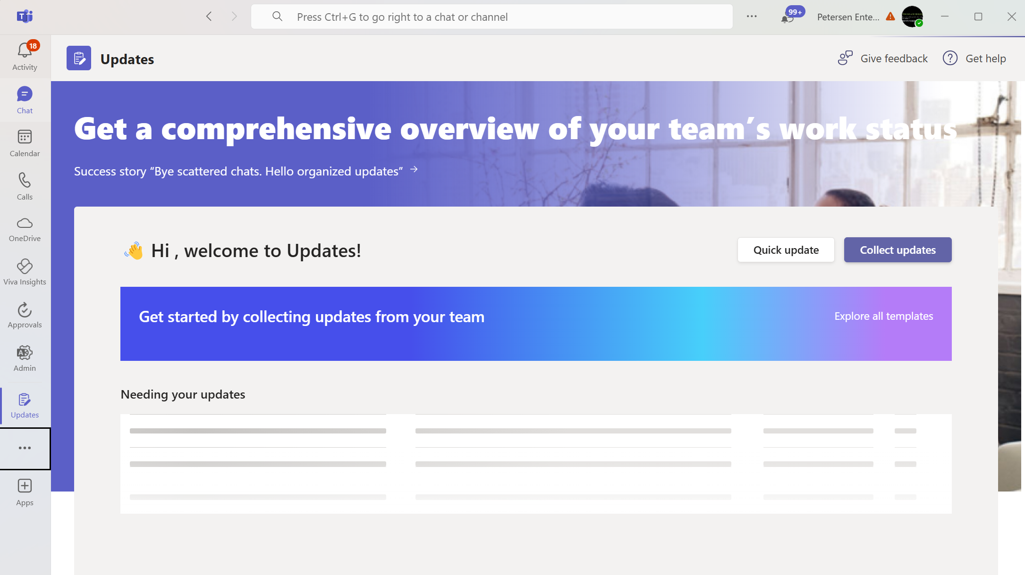
Overview of the Updates App
Centralized hub for tracking updates
Seamlessly integrates with team discussions and tasks
Customizable notifications for important changes
Supports both individual and team-based updates
Enhances visibility for project milestones and deadlines
Notes:
The Updates App in Microsoft Teams serves as a centralized hub that allows users to track important project updates efficiently. It integrates seamlessly with ongoing discussions and tasks, ensuring that team members stay informed. Users can customize notifications to focus on relevant changes, and it supports both individual and team updates, improving visibility for project milestones and deadlines.

Slide 19
Demo | Updates

Slide 20
Approvals

Slide 21
You have so many approvals to manage
Time-off requests
Vendor invoices
IT equipment
Budget planning
Marketing spend
Time sheets
Vendor discounts
Expense reports
Signature requests
Vehicle requests
Statements of work
Candidate offers
Audit approvals
Markdowns
Benefits enrollment
Customer proposals

Slide 22
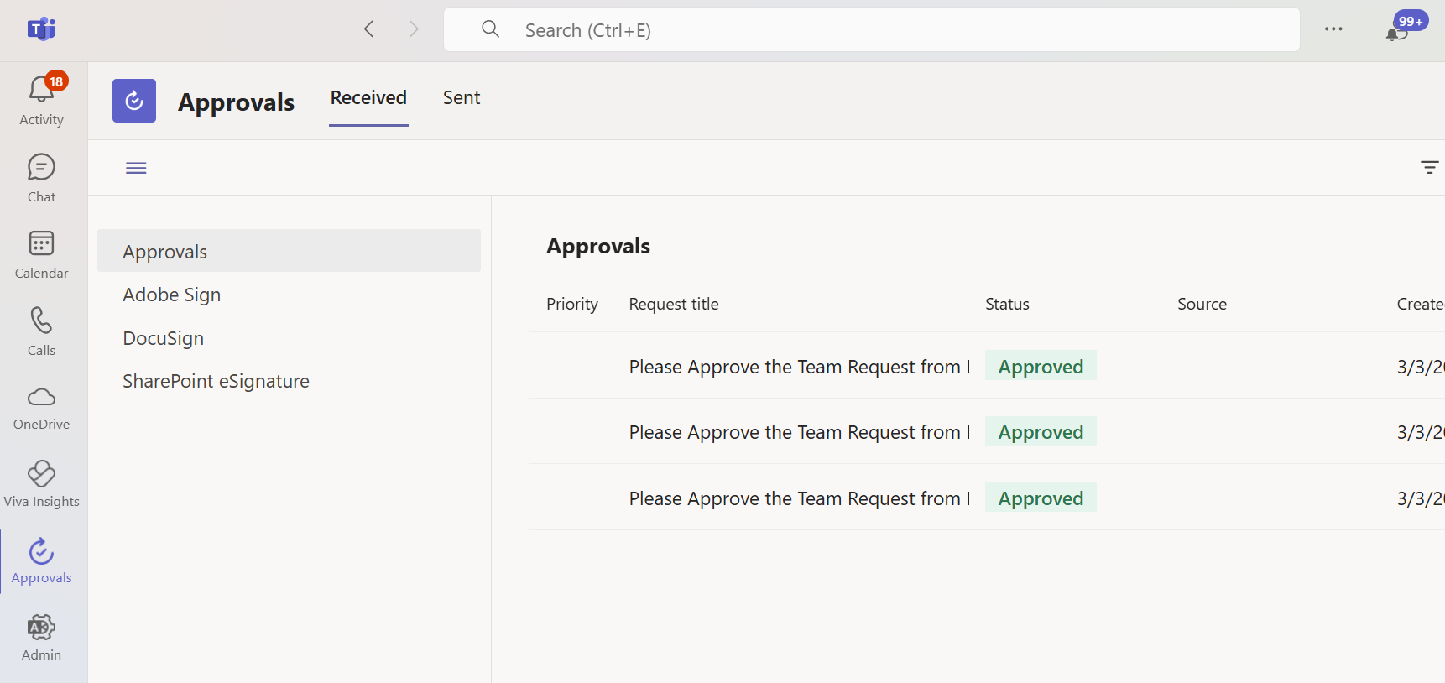
Approvals app in Teams keeps all your approvals in one place
Streamline processes
Digitize workflows
Automatically track

Slide 23
Demo | Approvals

Slide 24
Automate

Slide 25

Streamlining Workflows with Power Automate
Enhances efficiency by automating repetitive tasks
Integrates seamlessly with Microsoft Teams
Users can create automated workflows directly from Teams or use Power Automate
Notes:
Power Automate allows users to streamline their workflows by automating routine tasks. By integrating directly with Microsoft Teams, users can create workflows without leaving the app. This enhances collaboration and ensures that team members are more productive by focusing on high-value activities rather than repetitive processes.

Slide 26

Creating Flows within Teams
Easily build flows using Power Automate templates
Trigger flows directly from Teams conversations
Send automatic notifications to Teams channels
Automate posting messages to Teams channels based on triggers.
Enhance team communication with real-time updates.
Utilize flow actions to share important data automatically.
Notes:
Users can create flows in Power Automate by utilizing pre-built templates that simplify the process. Flows can be triggered directly from conversations in Teams, allowing for responsive actions. Additionally, automated notifications can be sent to Teams channels to keep everyone informed of important updates and actions.

Slide 27
The benefits of a low-code development platform
Efficiency
Teams can simultaneously develop apps for multiple platforms and rapidly provide working examples
Flexibility
Create flexible apps that accomplish specific tasks. That flexibility is critical for scaling and extending apps to quickly finish projects
Responsiveness
Easily pivot to accommodate roller-coaster market shifts with new digital initiatives
Iterability
Provide customers with a consistent, frictionless experience using prebuilt templates and chatbots
Low-code platforms are also a great option for professional developers. Many low-code platforms are extensible and offer building blocks that are intended for developers to use, which makes these platforms a smart choice for any user.

Slide 28
Demo | Automate

Slide 29
Questions?
🤔
Notes:
Please repeat any questions so that they are captured in the recording.

Slide 30
Thank You!

